Slide 1
Old Challenges and New Hopes in Heart Failure
Ify Mordi
BHF Intermediate Clinical Research Fellow and Clinical Senior Lecturer in Cardiology
University of Dundee
Postgraduate Course in Advanced Diabetes, Istanbul
22nd November 2024

Slide 2
The Challenge of Cardio-Renal Metabolic Disease: Working in Silos

Slide 3
Cardio-Renal Metabolic Disease: Now Working Together!

Slide 4
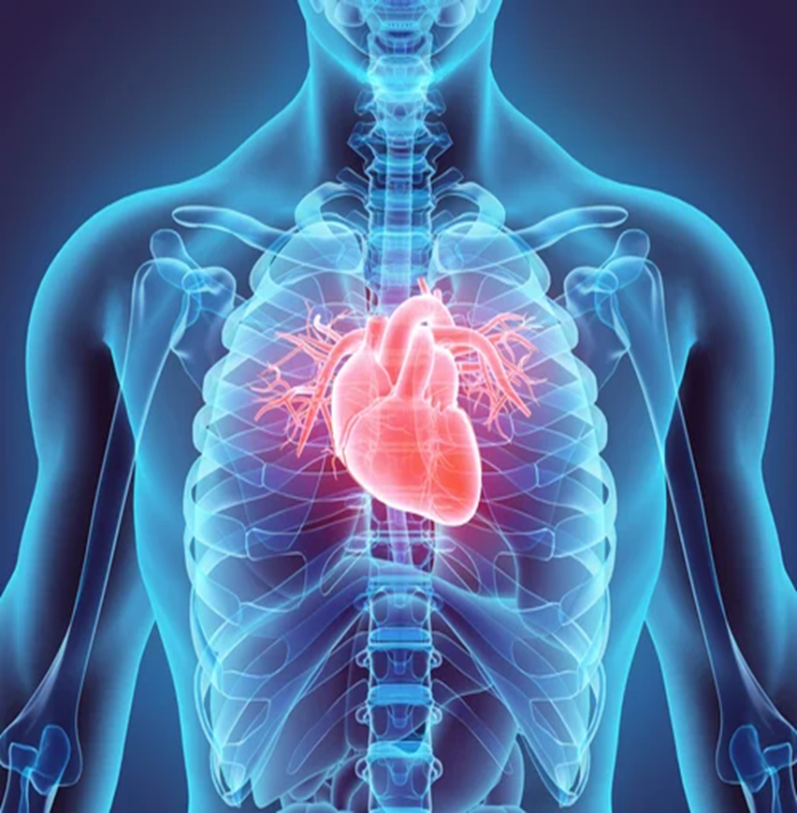
Heart Failure – A Growing Epidemic
A clinical syndrome consisting of:
Symptoms (Breathlessness, swelling, fatigue)
Clinical signs (lung crackles, oedema, raised JVP)
Due to a cardiac structural or functional abnormality resulting in:
Elevated intracardiac pressure (“stiff heart”)
Inadequate cardiac output (“weak heart”)
ESC HF Guidelines 2021

Slide 5
Heart Failure – A Growing Epidemic
Around 1-2% of the adult population have known HF
Estimated prevalence of heart failure in people aged ≥60 years is 4.2%
HF is the number one cause of hospitalisation in people >65 years
5-year mortality rate for patients with HF is ~50%
Rising significantly with 40% of newly diagnosed patients dying within a year
Conrad et al. Lancet, 2018
Jones et al. EJHF 2019

Slide 6
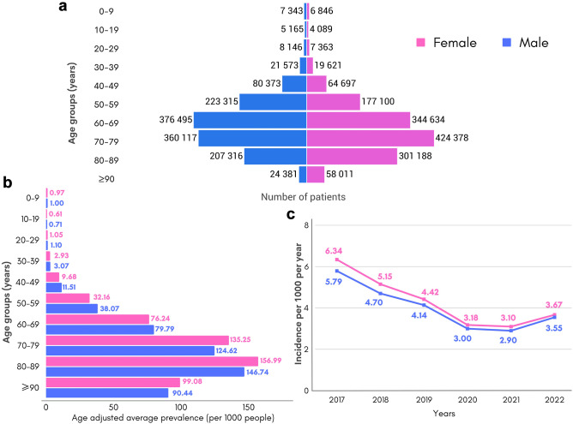
Heart Failure in Turkiye
Overall 2.1% of the Turkish population had HF in 2022 (2.2 vs. 2.0 F/M ratio)
Mean age 69 years
Celik et al. Lancet Global Health, 2023

Slide 7
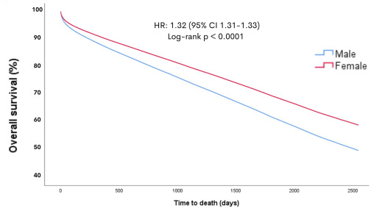
Heart Failure in Turkiye
17% mortality at 1 year; 40% at 5 years.
Males worse outcome than females in age-adjusted analysis (32% relative risk increase)
Celik et al. Lancet Global Health, 2023

Slide 8
Diagnosing Heart Failure
Initial Investigations
Natriuretic peptides (BNP/NTproBNP)
Electrocardiogram
Chest X-ray
FBC/U+E/LFT/TFT
Suspected HF in an at-Risk Patient
Dyspnoea, oedema, fatigue
Elevated JVP, congestion
If BNP>35/NT-proBNP>125
Echocardiography

Slide 9
Heart Failure Subtypes
HF with preserved cardiac function
(HFpEF)
HF with reduced cardiac function (HFrEF)

Slide 10
Heart Failure Subtypes
HF with mildly reduced EF (HFmrEF)
HF with reduced EF (HFrEF): EF ≤40%
EF 41%–49%
HF with preserved EF (HFpEF): EF ≥50%
HF with improved EF (HFimpEF)
EF increases ≥10% from HFrEF then EF >40%²²
~60% of people with HF and LVEF ≤40%³
~40%
of people with HF and LVEF >40%³
ESC definitions:⁴
Type of HF |  | HFrEF | HFmrEF | HFpEF
Criteria | 1 | Symptoms ± signs* | Symptoms ± signs* | Symptoms ± signs*
 | 2 | LVEF ≤40% | LVEF 41–49%† | LVEF ≥50%
 | 3 |  |  | Objective evidence of cardiac structural and/or functional abnormalities consistent with the presence of LV diastolic dysfunction/raised LV filling pressures, including raised natriuretic peptides‡
*Signs may not be present in the early stages of HF (especially in HFpEF) and in optimally treated patients. †For the diagnosis of HFmrEF, the presence of other evidence of structural heart disease (e.g., increased left atrial size, LV hypertrophy, or echocardiographic measures of impaired LV filling) makes the diagnosis more likely. ‡For the diagnosis of HFpEF, the greater the number of abnormalities present, the higher the likelihood of HFpEF.
1. McDonagh TA et al. Eur Heart J. 2021;42:3599–3726; 2. Wilcox JE et al. J Am Coll Cardiol. 2020:76: 719–734; 3. National Heart Failure Audit 2021. https://www.hqip.org.uk/wp-content/uploads/2021/10/NHFA-Domain-Report_2021_FINAL.pdf Accessed September 2023; 4. McDonagh TA et al. Eur Heart J. 2023;00:1–13. DOI: 10.1093/eurheartj/ehad195.

Slide 11
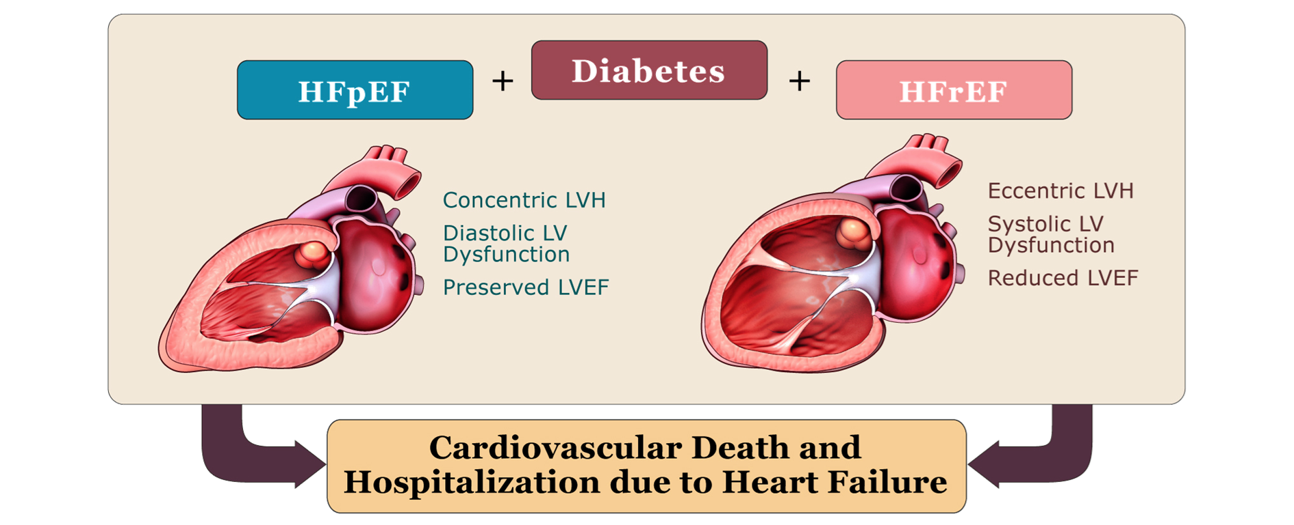
Heart Failure Subtypes

Slide 12
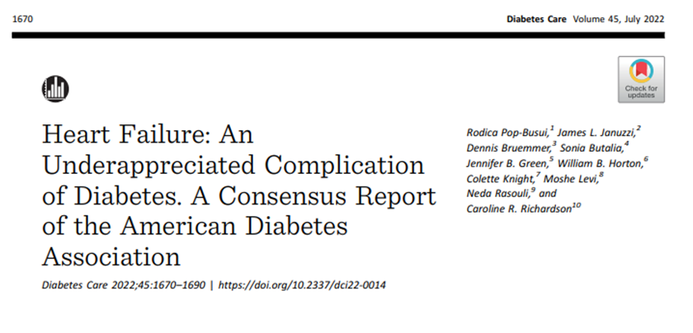
Heart Failure in Diabetes is Under-Recognised
First
Frequent
Forgotten

Slide 13
Heart Failure is Often the First CVD Complication to Manifest in Diabetes
Based on a cohort study in UK patients with T2DM (N=6,137) who had a first presentation of CV disease. Note: HF post-MI was not included in this definition of HF
Presentation of CV Disease in T2D
CV: cardiovascular; CVD: cardiovascular disease; HF: heart failure; MI: myocardial infarction; T2DM: Type 2 diabetes mellitus
1. Shah AD, et al. Lancet Diabetes Endocrinol. 2015;3(2):105-13. DOI: 10.1016/S2213-8587(14)70219-0

Slide 14
Frequent: Early signs of heart failure damage could be present within 5 years
Diastolic
LVD
Normal LV
function
68% had evidence of LV dysfunction 5-years after their T2DM diagnosis
Systolic LVD
Systolic and
diastolic LVD
Based on a prospective study of 386 people with T2DM without overt cardiac disease
CV: cardiovascular; CVD: cardiovascular disease; HF: heart failure; MI: myocardial infarction; T2DM: Type 2 diabetes mellitus
Faden G, et al. Diabetes Res Clin Pract. 2013;101(3):309-16. DOI: 10.1016/j.diabres.2013.07.004

Slide 15
Forgotten: 28% of patients in a Type 2 Diabetes population had undiagnosed Heart Failure
HF with reduced ejection fraction
HF with preserved ejection fraction
No HF
Based on a cross-sectional study of 581 patients aged 60 years or over with T2DM
CV: cardiovascular; CVD: cardiovascular disease; HF: heart failure; MI: myocardial infarction; T2DM: Type 2 diabetes mellitus
1. Boonman-de Winter LJM, et al. Diabetologia. 2012; 55(8): 2154–2162. DOI: 10.1007/s00125-012-2579-0

Slide 16
Even “Stable” HF Patients are at Higher Risk than High-Risk ASCVD Patients
HEART FAILURE
Advanced HFrEF intolerant/refractory to GDMT, recurrent HF hospitalisations
VERY EXTREME HIGH RISK
HFrEF and recent HF hospitalisation or worsening HF
~40%
EXTREME HIGH RISK
This “stable” patient has a risk greater than that of a “very high risk” ASCVD patient
“Stable” outpatient HFrEF, NYHA class II, no recent hospitalisations
CARDIOVASCULAR DEATH or HF HOSPITALISATION (RISK/YEAR)
~10%
ASCVD
Multiple ASCVD events, or 1 ASCVD event + multiple high-risk conditions
7%
VERY HIGH RISK
NOT APPLICABLE TO HEART FAILURE PATIENTS
6%
5%
MYOCARDIAL INFARCTION or ISCHAEMIC STROKE (RISK/YEAR)
4%
HIGH RISK
Primary or secondary prevention
3%
Primary prevention
2%
INTERMEDIATE RISK
Primary prevention
1%
BORDERLINE RISK
LOW RISK
ASCVD, atherosclerotic cardiovascular disease. GDMT; Guideline Directed Medical Therapy. HF; Heart Failure. HFrEF; Heart Failure with Reduced Ejection Fraction. NYHA; New York Heart Association.
Greene SJ, et al. JAMA 2021; 326(suppl):2261–2262; Lam CSP, et al. JAMA Cardiol 2021; 6:706–712

Slide 17
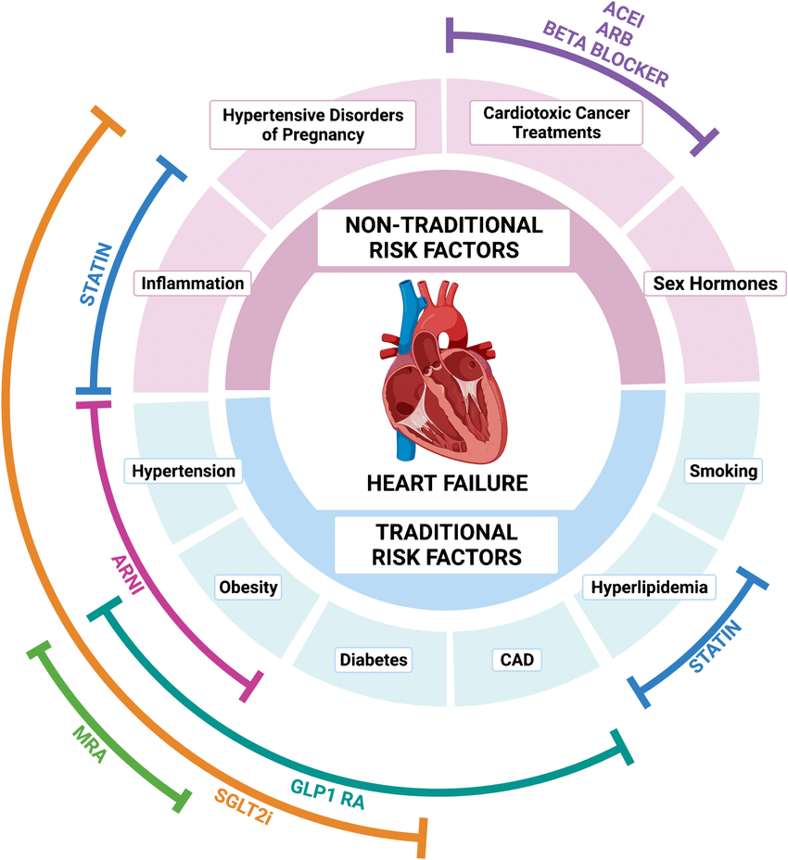
Risk Factors for Heart Failure
Everitt et al. Curr Ath Reports 2022

Slide 18
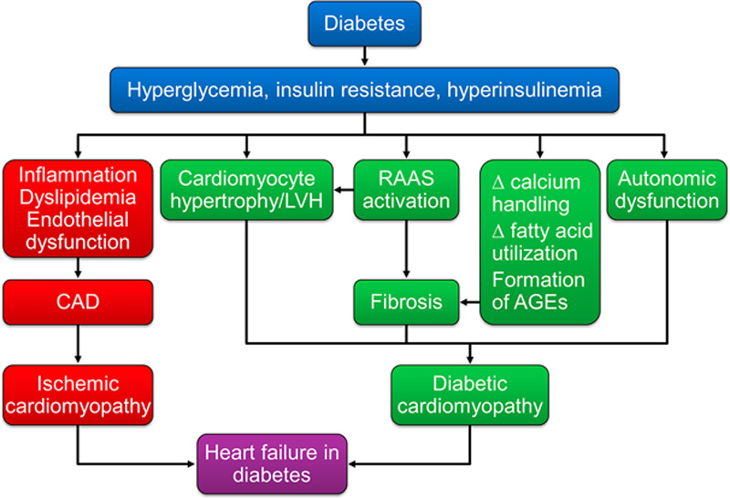
Pathophysiology of Heart Failure in Diabetes
Dunlay et al. Circulation 2019

Slide 19
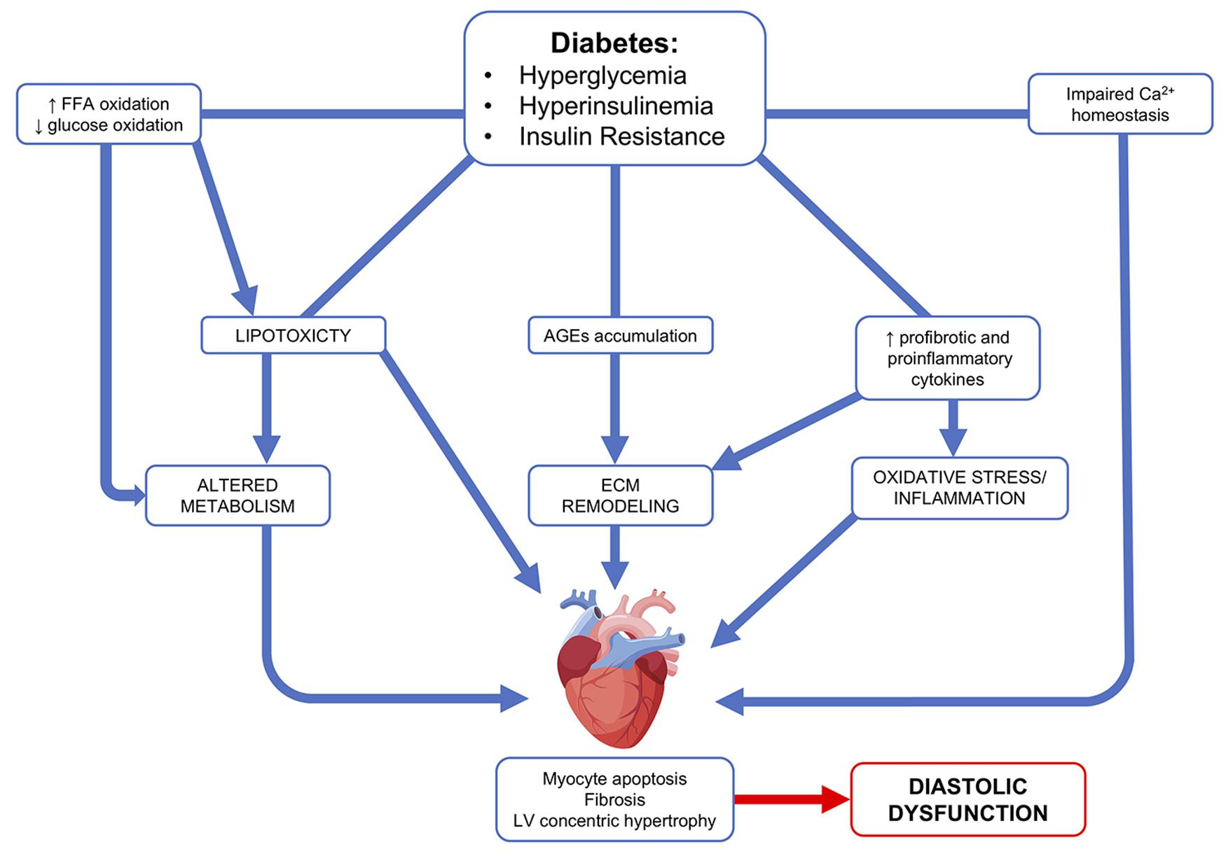
Pathophysiology of Heart Failure in Diabetes

Slide 20
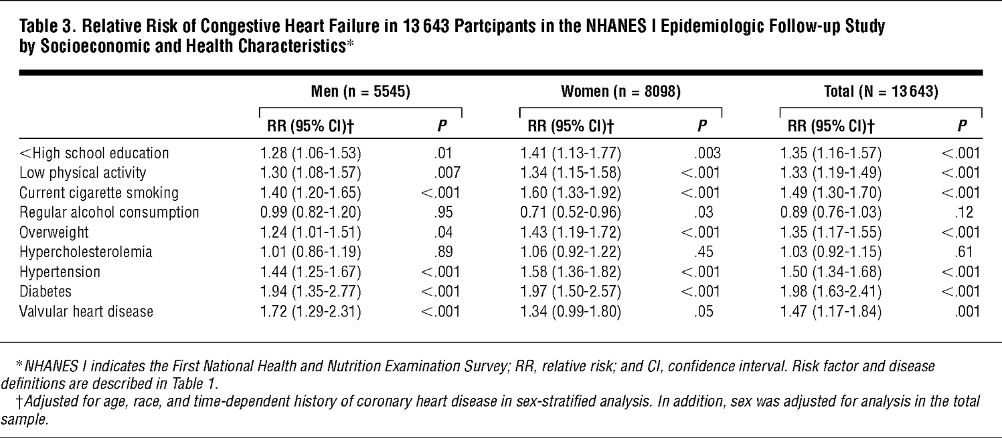
Diabetes Increases the Risk of Incident Heart Failure
Diabetes associated with a doubling of the risk of incident HF
He et al. JAMA Internal Med 2001

Slide 21
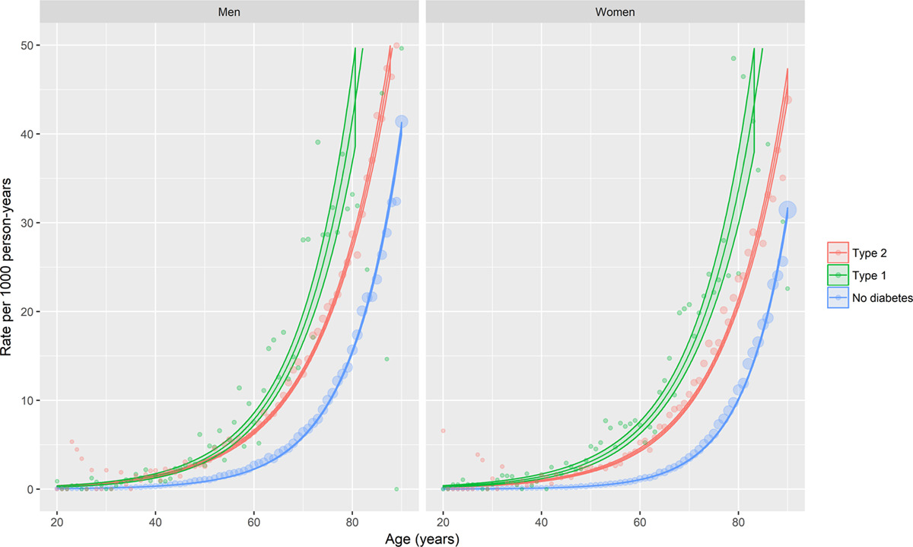
Heart Failure Occurs at a Younger Age in Diabetes
McAllister et al. Circulation 2019

Slide 22
Diabetes Increases the Risk of Incident Heart Failure
Males
Females
Ohkuma et al. Diabetologia 2019

Slide 23
Diabetes is Highly Prevalent in Individuals with Heart Failure
Trial | HF Type | Percentage with Diabetes
MERIT-HF (1999) | HFrEF | 25
EMPHASIS-HF (2011) | HFrEF | 31
PARADIGM-HF (2014) | HFrEF | 35
TOPCAT (2014) | HFpEF | 32
PARAGON-HF (2019) | HFpEF | 43
VICTORIA (2020) | HFrEF | 47
FINEARTS-HF (2024) | HFpEF | 41
Increasing prevalence

Slide 24
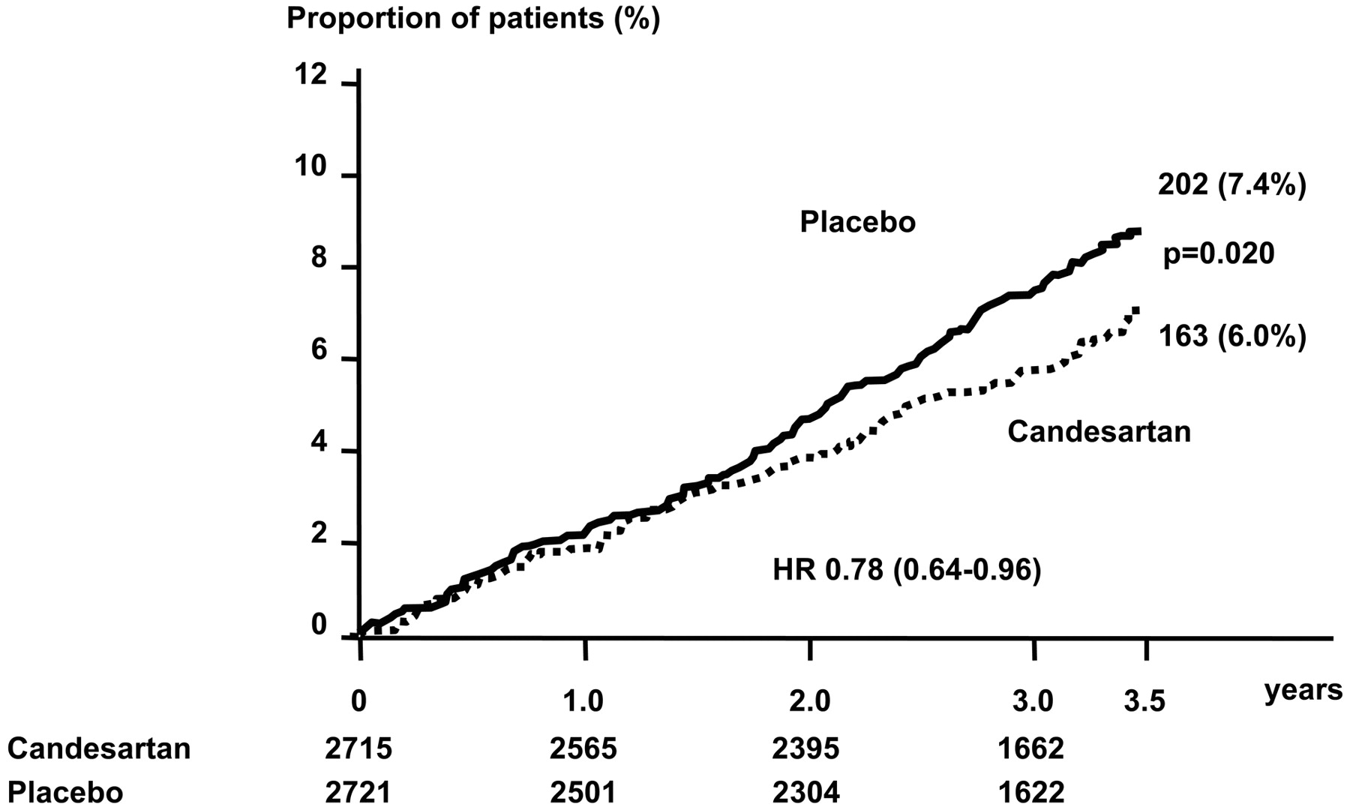
Bidirectional Relationship – Heart Failure is Associated with High Risk of Incident Diabetes
In CHARM, incidence of new diabetes in HF patients ~7% at 3 years
Yusuf et al. Circulation 2005

Slide 25
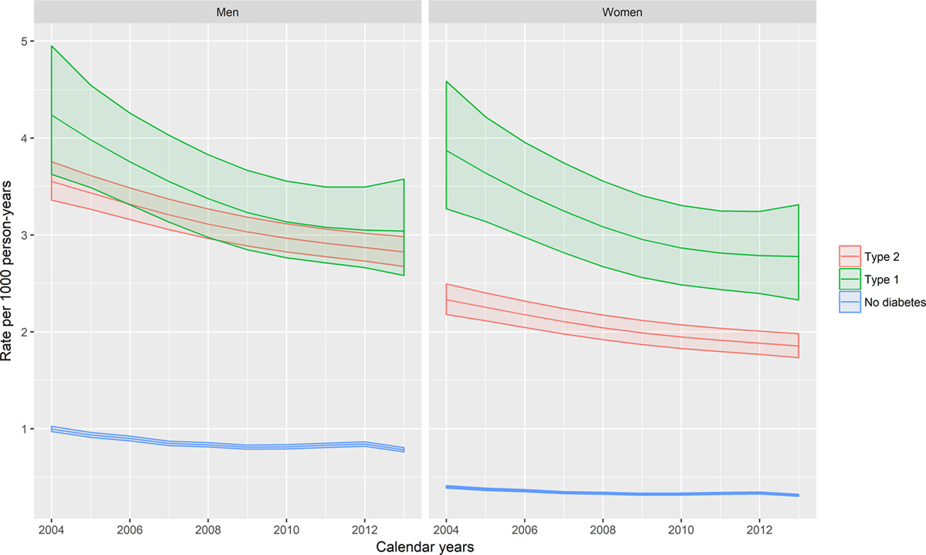
Individuals with Diabetes Are More Likely To Have a HF Hospitalisation
McAllister et al. Circulation 2019

Slide 26
Diabetes is Associated Worse Outcome in HF Independent of Aetiology or LVEF
McDonald et al. EHJ 2008
Notes:
CHARM

Slide 27
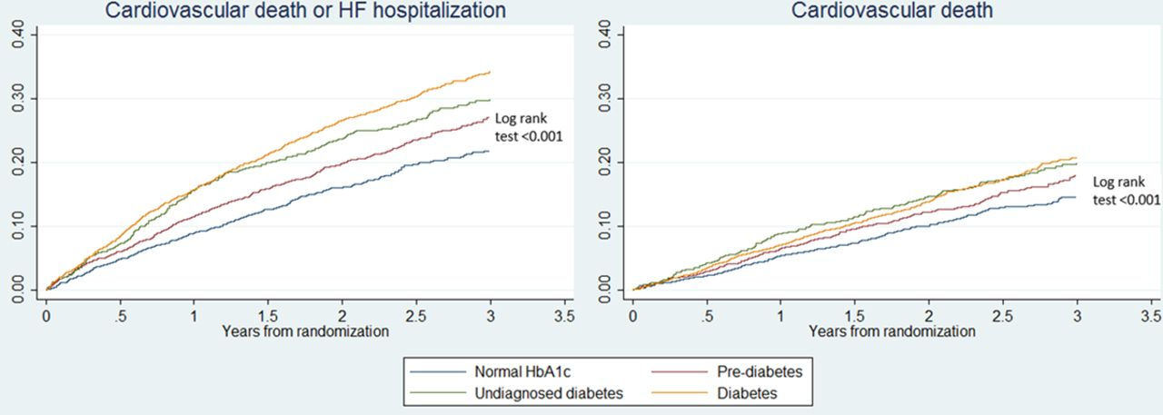
Pre-Diabetes is Associated Worse Outcome in HF
HR for primary outcome compared to non-diabetics
Diabetes 1.64 (1.44-1.88), p<0.001
Pre-diabetes 1.28 (1.11-1.47), p=0.001
Kristensen et al. Circ HF 2016
Notes:
CHARM

Slide 28
How Do We Improve The Situation?
Better Treatments
Treatment of HF in Diabetes
Diabetes Treatments in HF
Better Detection
Screening for HF in Diabetes

Slide 29
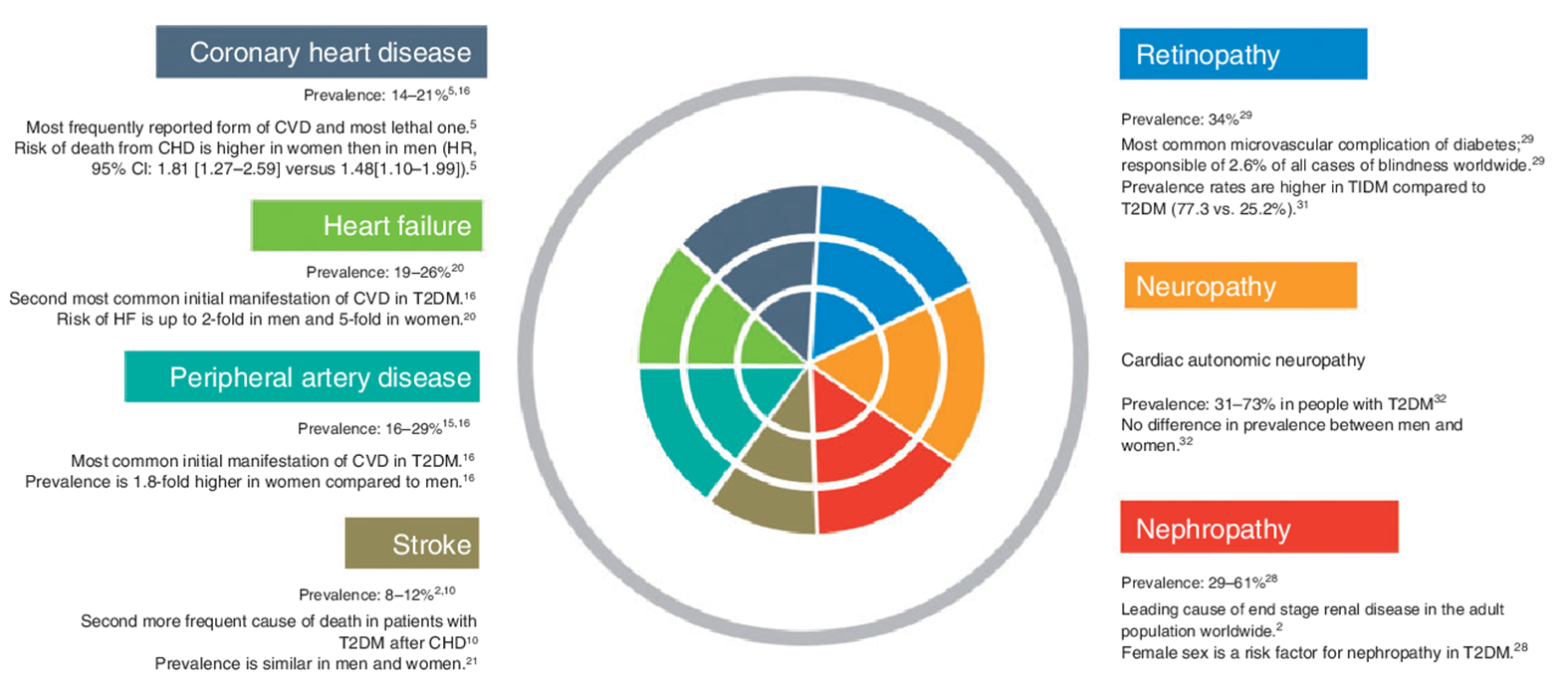
Diabetes (Annual) Screening
HbA1c; BP, cholesterol, weight; Renal function; Eye test; Foot check

Slide 30
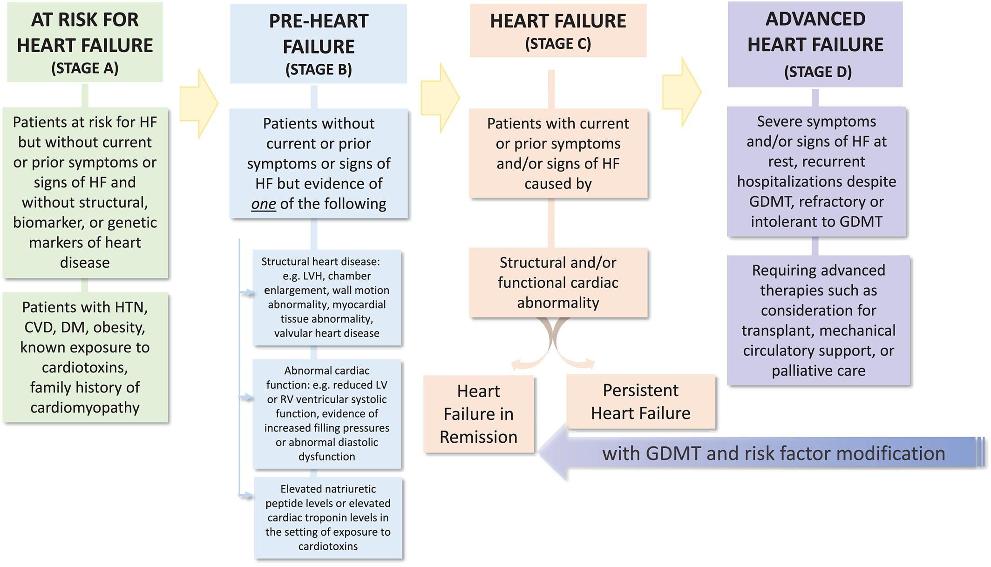
Progression of HF: A “Latent” (Subclinical) Phase
To here?
Can we shift diagnosis from here?
Bozkurt et al. EJHF 2021

Slide 31
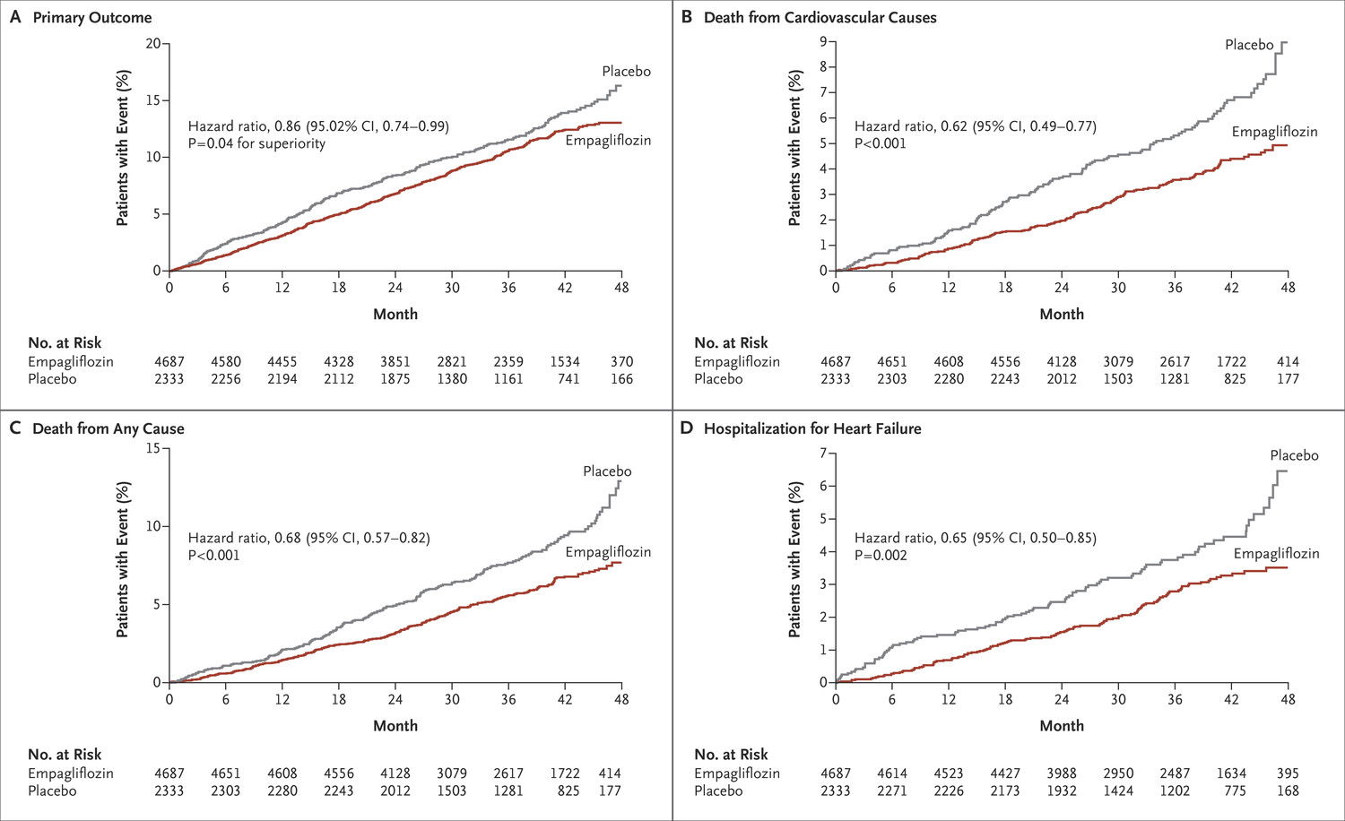
Management in Stage A HF: SGLT2i
Zinman et al. NEJM 2015

Slide 32
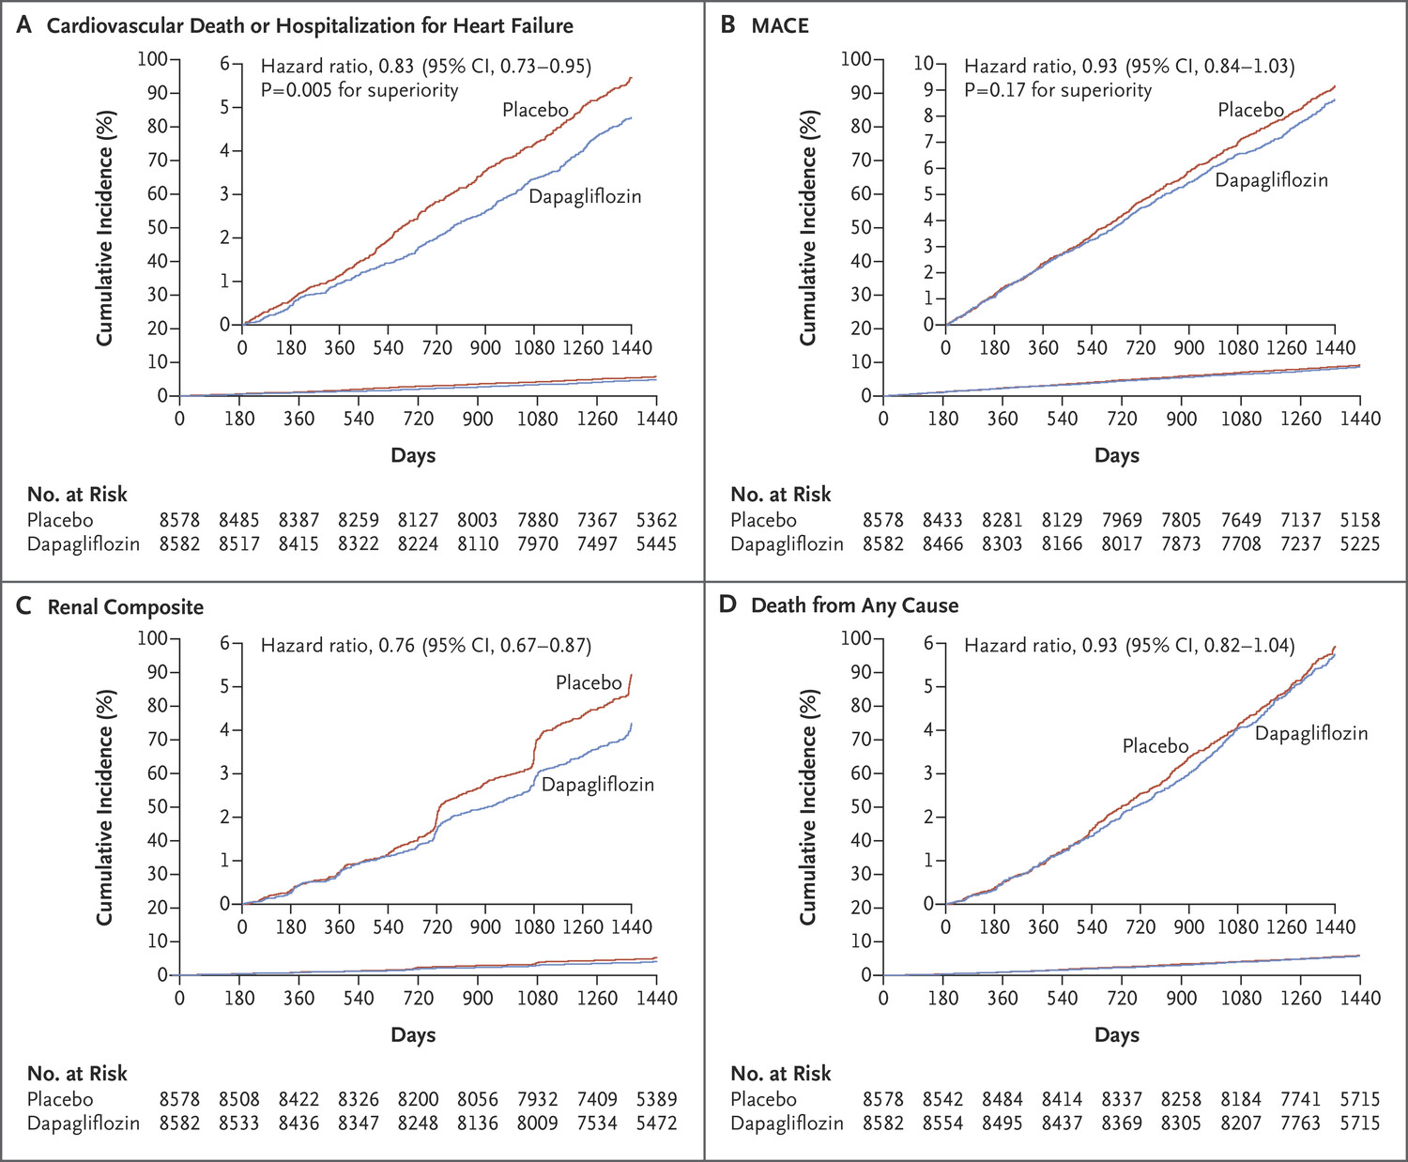
Management in Stage A HF: SGLT2i
Wiviott et al. NEJM 2019

Slide 33
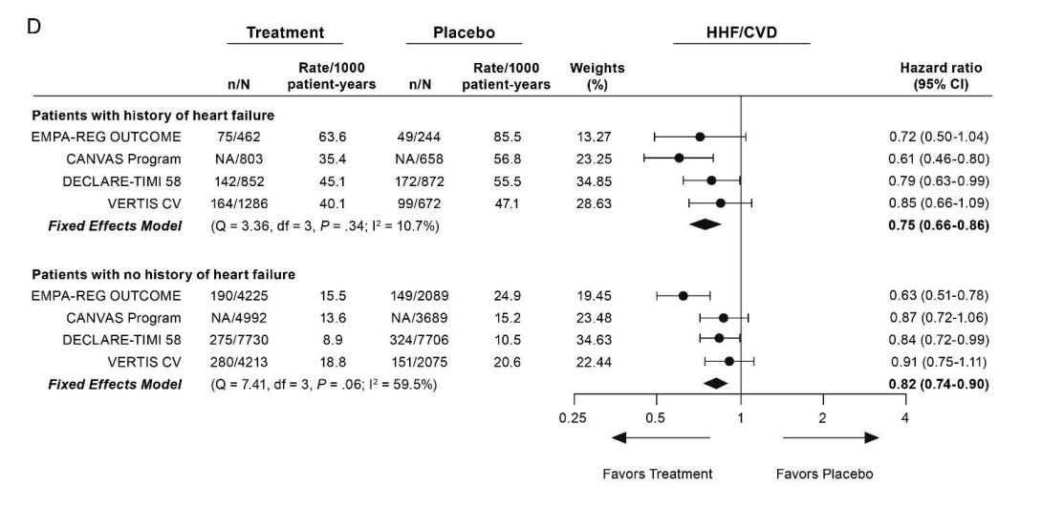
HF-related Benefits of SGLT2i are Independent of HF History at Baseline
McGuire et al. JAMA Cardiol 2020

Slide 34
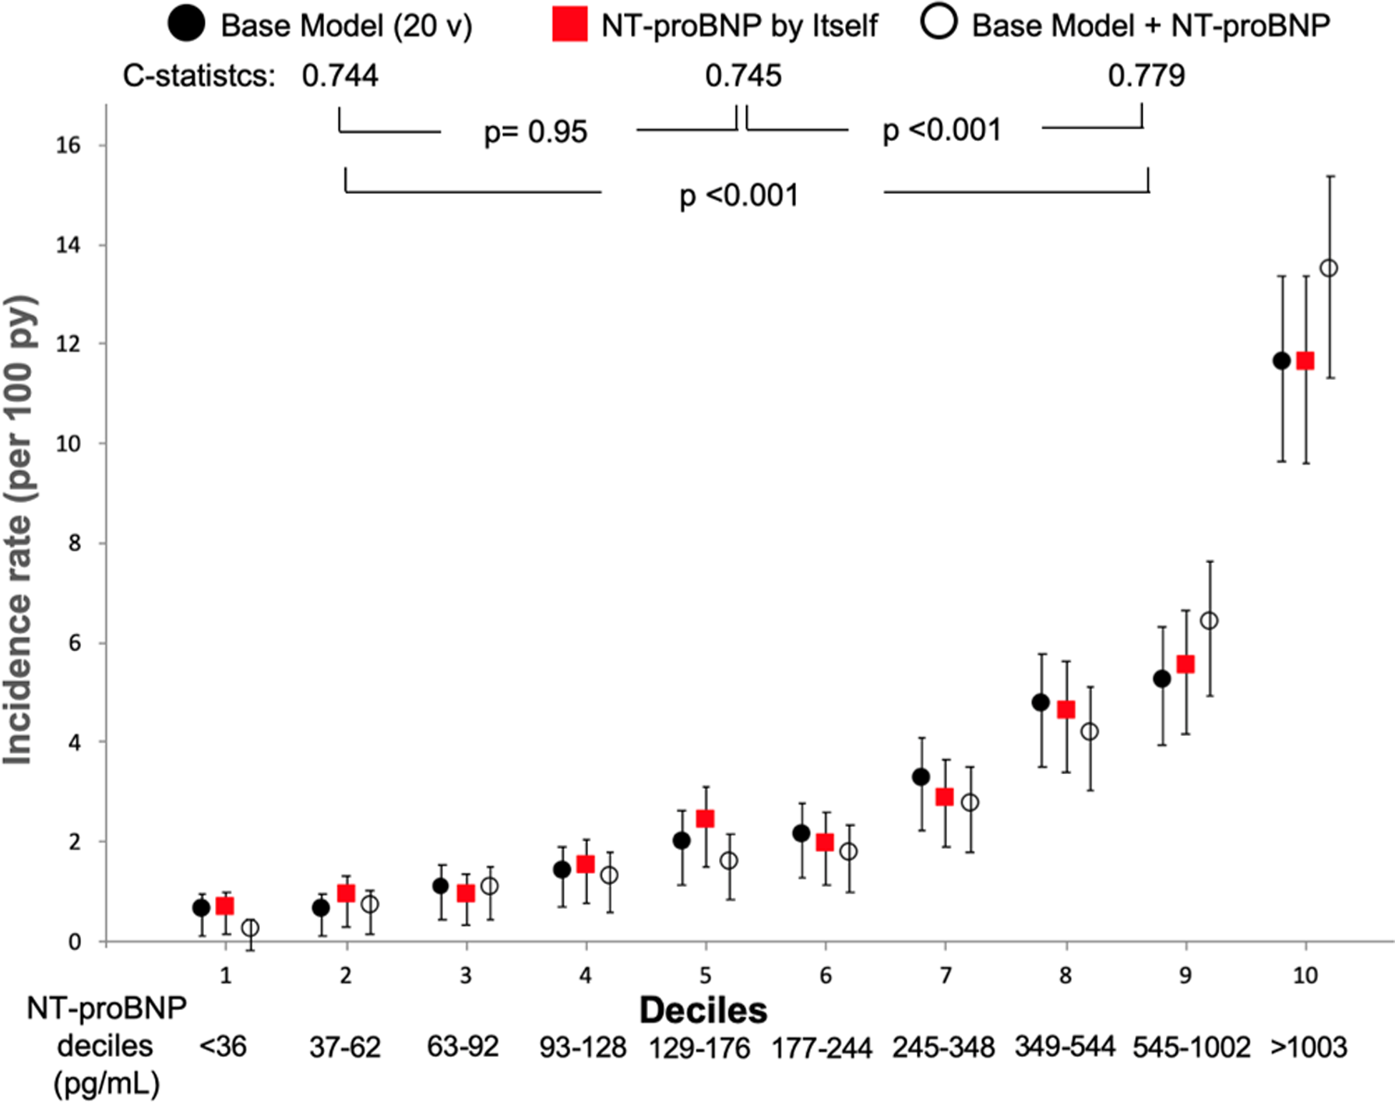
Use of Biomarkers in Heart Failure
Malachias et al., JAHA 2020

Slide 35
Use of Biomarkers in Heart Failure
In SAVOR-TIMI increased NTproBNP was associated with adverse CV risk
Scirica et al., JAMA Cardiol 2016

Slide 36
Use of Biomarkers in Heart Failure and Diabetes
In SAVOR-TIMI increased NTproBNP was associated with adverse CV risk
Scirica et al., JAMA Cardiol 2016

Slide 37
Elevated Natriuretic Peptides are Associated with Diastolic Dysfunction in T1D
Rorth et al., Eur J Endo 2020

Slide 38
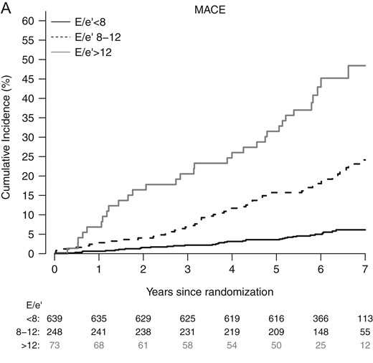
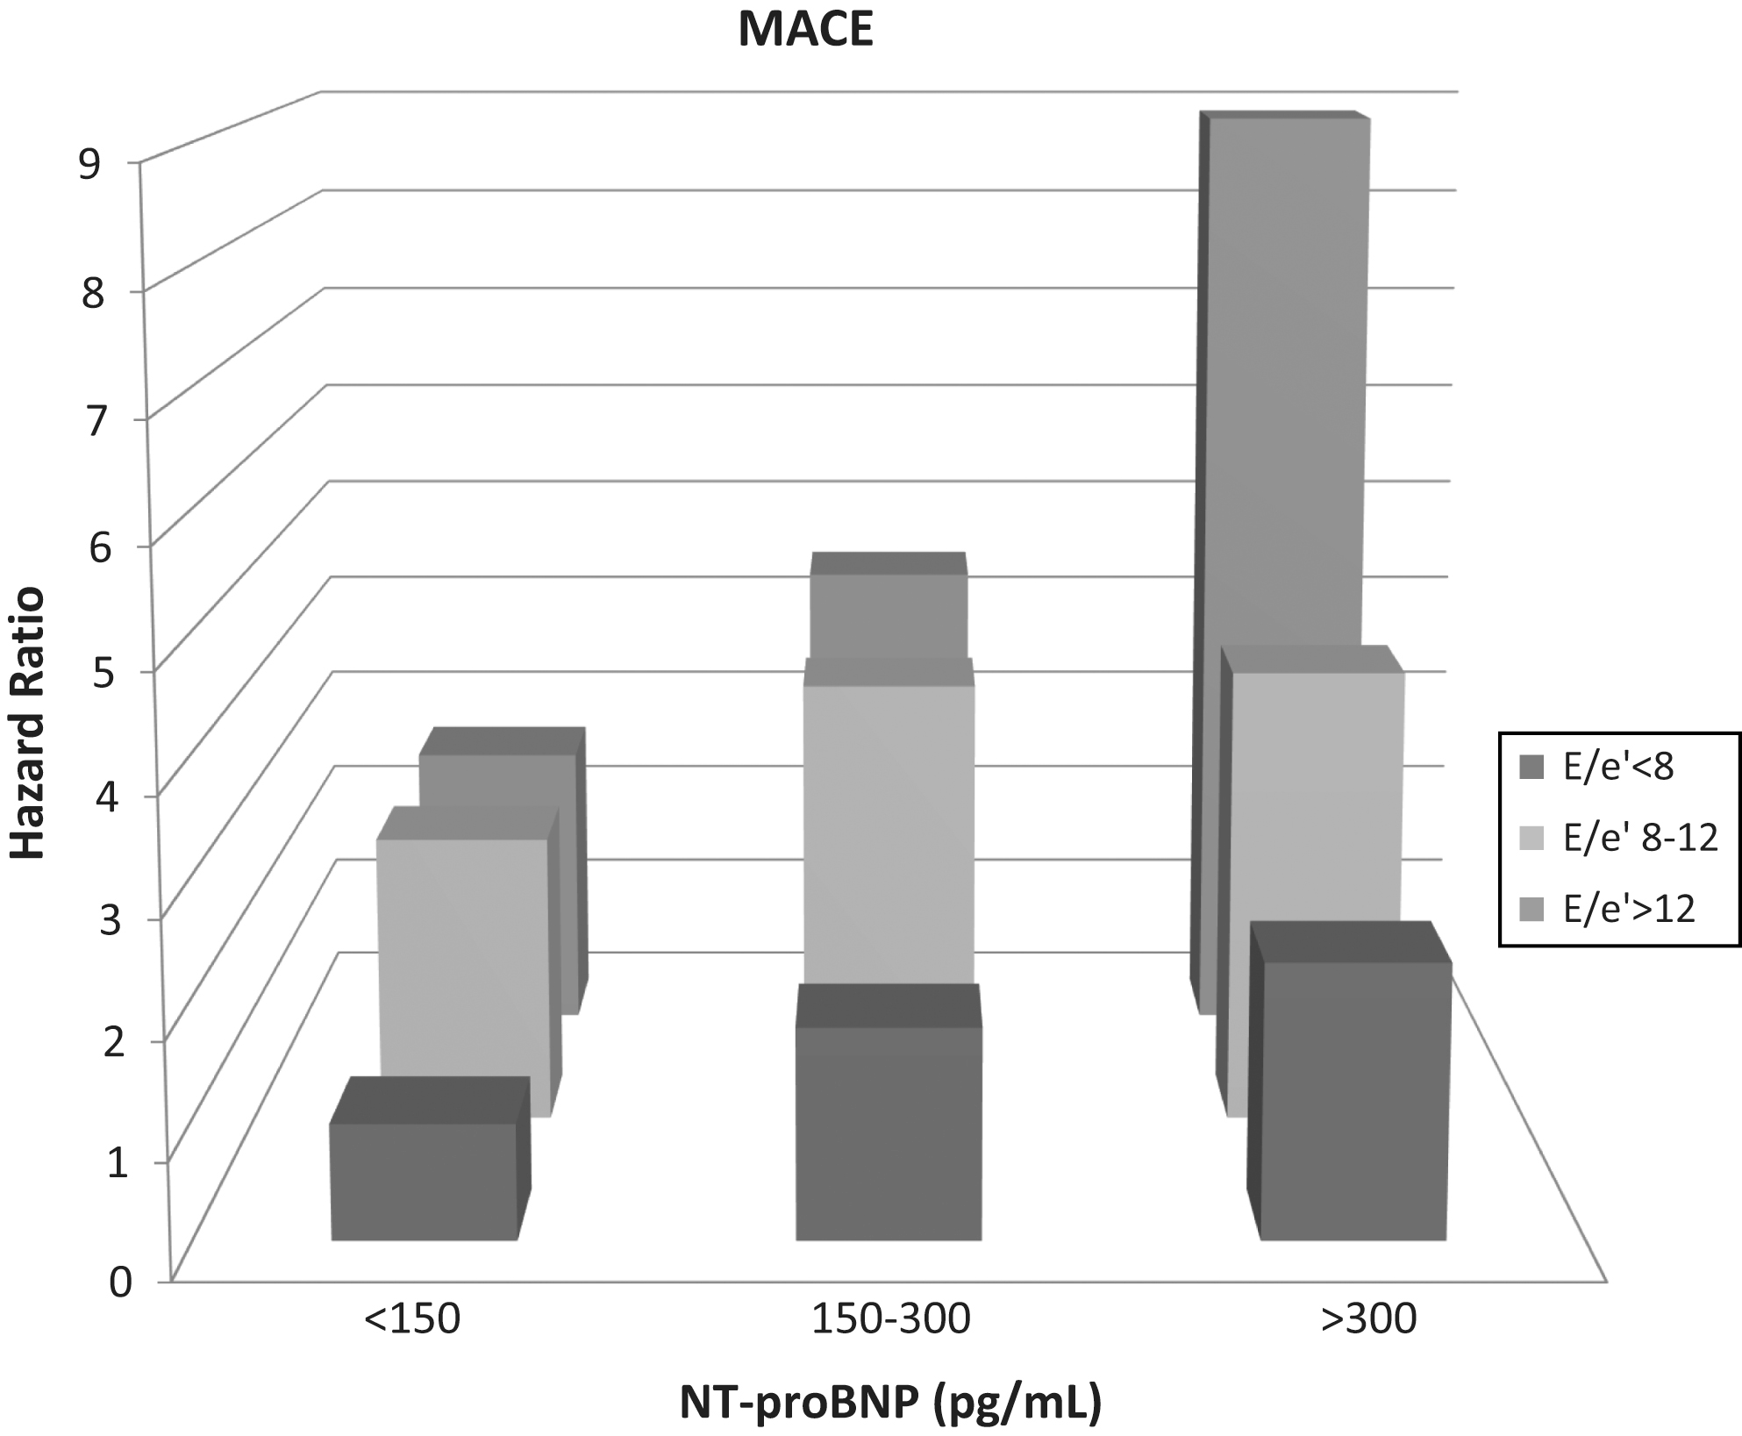
Elevated Natriuretic Peptides are Associated with Diastolic Dysfunction in T1D
Rorth et al., Eur J Endo 2020

Slide 39
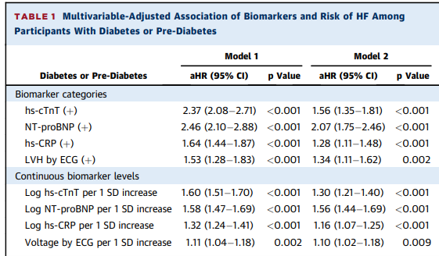
Multimarker Screening Strategies
6,799 individuals with diabetes or pre-diabetes – combining multiple biomarkers to predict HF (4-fold risk increase with score 3-4).
Pandey et al. JACC 2021

Slide 40
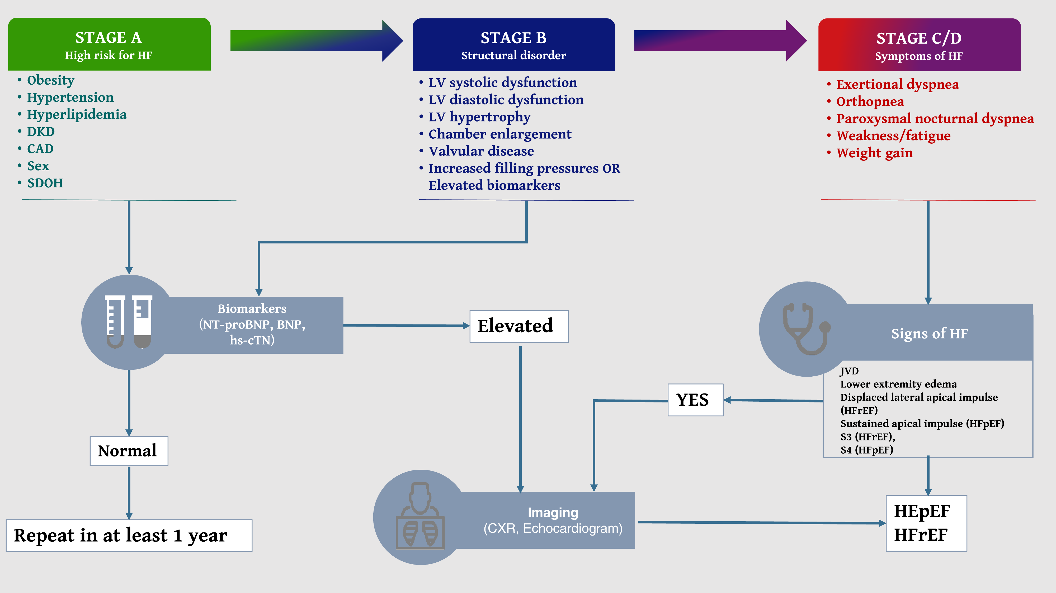
Natriuretic Peptides to Predict HF in Diabetes
Pop-Busui et al. Diabetes Care 2021

Slide 41
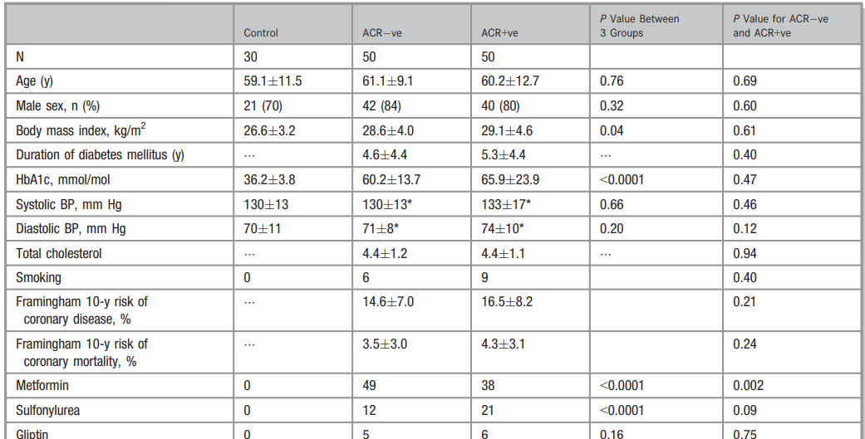
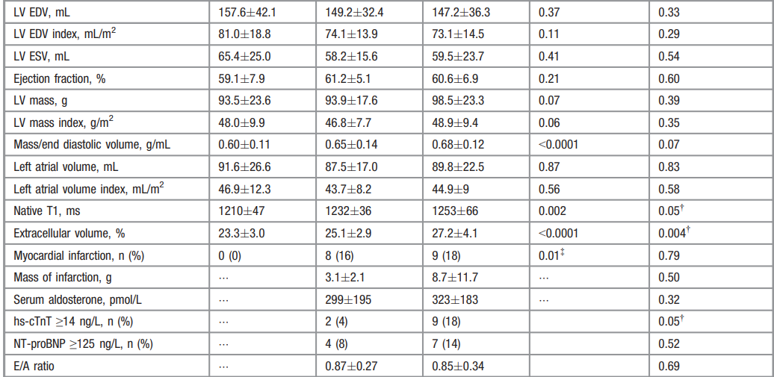
Natriuretic Peptides to Predict HF in Diabetes: Should We be More Selective?
Swoboda et al. JAHA 2017

Slide 42
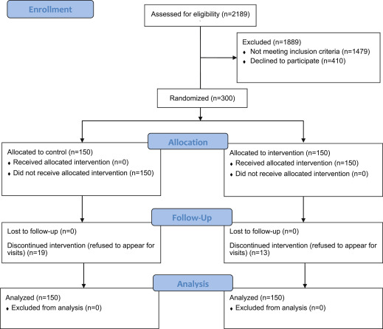
Potential for Treatment Intervention in Asymptomatic Disease (Stage B HF)
PONTIAC Trial
Individuals with ↑ NTproBNP but no overt CVD
ACEI/beta-blocker initiation/uptitration until max dose or NTproBNP ↓50% vs. usual care
Mean duration of diabetes 16 years, 42% female
Huelsmann et al. JACC 2013

Slide 43
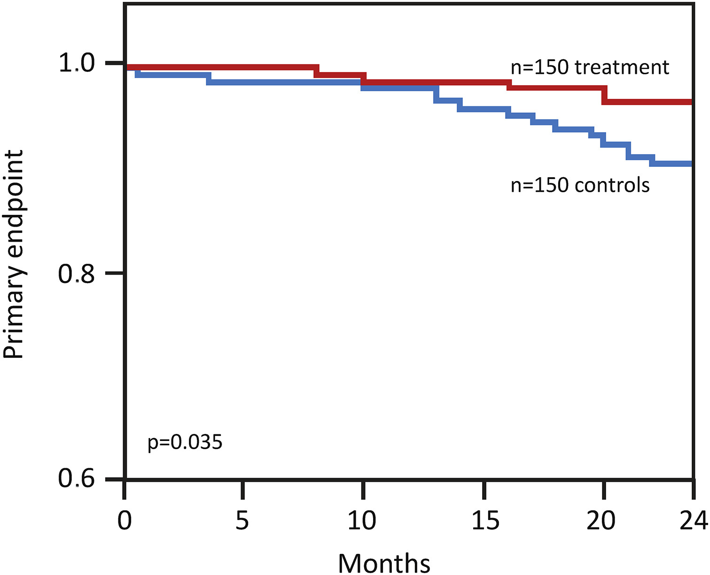
Potential for Treatment Intervention in Asymptomatic Disease (Stage B HF)
No significant difference in NTproBNP at 12 months between groups
Significantly more ACEI/beta-blocker use in intensive arm
Significant reduction in CV death/hospitalisation at 2 years with intensive treatment (HR 0.35 (0.13-0.98, p=0.04)
Huelsmann et al. JACC 2013

Slide 44
Stage A and B HF
SGLT2 Inhibitors consistently improve outcomes for those at-risk of HF (i.e. everyone with diabetes!)

Slide 45
Treatment of Stage C/D Heart Failure is the Same With or Without Diabetes
HFrEF
Greene et al. JACC 2023

Slide 46
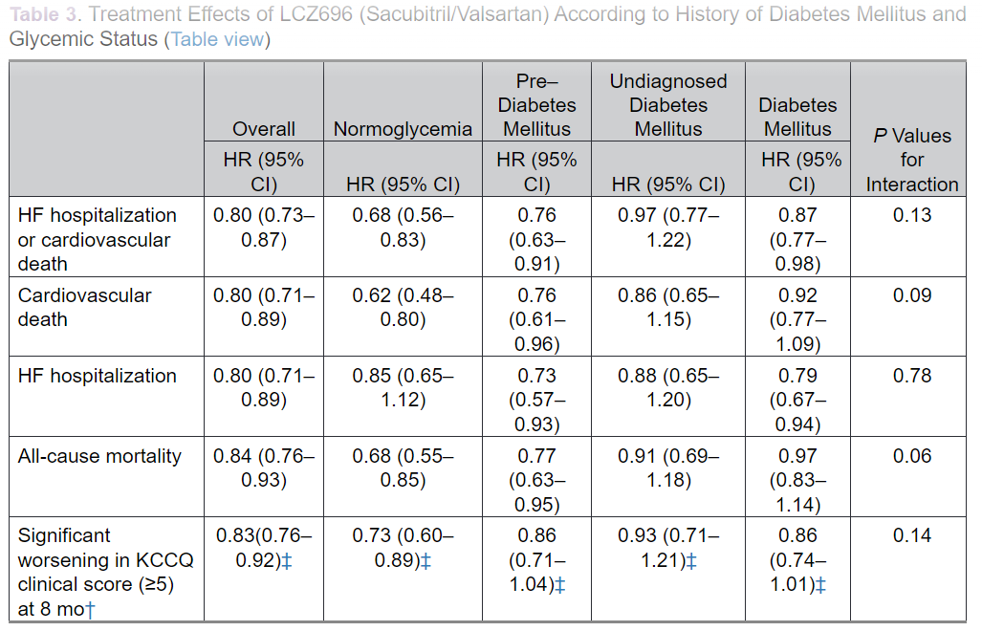
Consistent Beneficial Effects Irrespective of Diabetes Status: Sacubtril/Valsartan
Kristensen et al. Circ HF 2016

Slide 47
SGLT2i in HFrEF
4,744 patients
≥18 years of age
LVEF ≤40%
With or without T2D
Symptomatic HFrEF (NYHA class II-IV*)
Elevated NT-proBNP*
eGFR ≥30 mL/min/1.73 m²
Stable SoC treatment for HFrEF
1:1 Double-blind
Dapagliflozin 10 mg + standard of care** (n=2373)
Placebo + standard of care*** (n=2371)
Median follow-up: 18.2 months
Key prespecified subgroups included patients:
With or without T2D
Aged ≤65 years or >65 years
With LVEF ≤median or LVEF >median
McMurray et al. NEJM 2019

Slide 48
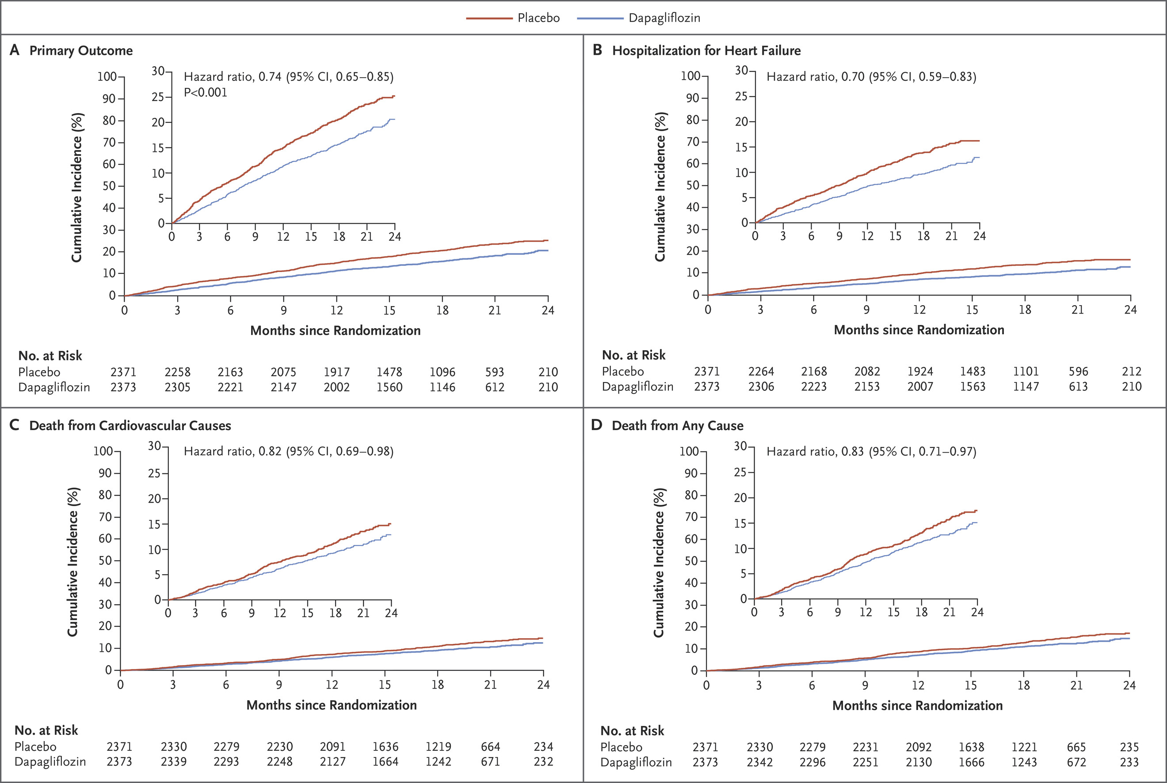
SGLT2i in HFrEF
26% RRR
30% RRR
McMurray et al. NEJM 2019

Slide 49
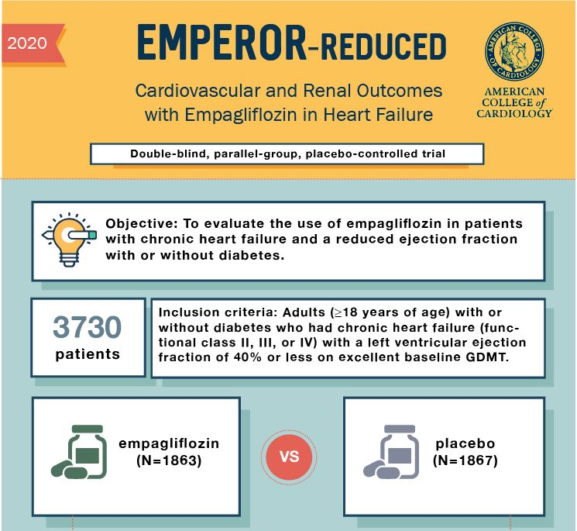
SGLT2i in HFrEF
Packer et al. NEJM 2020

Slide 50
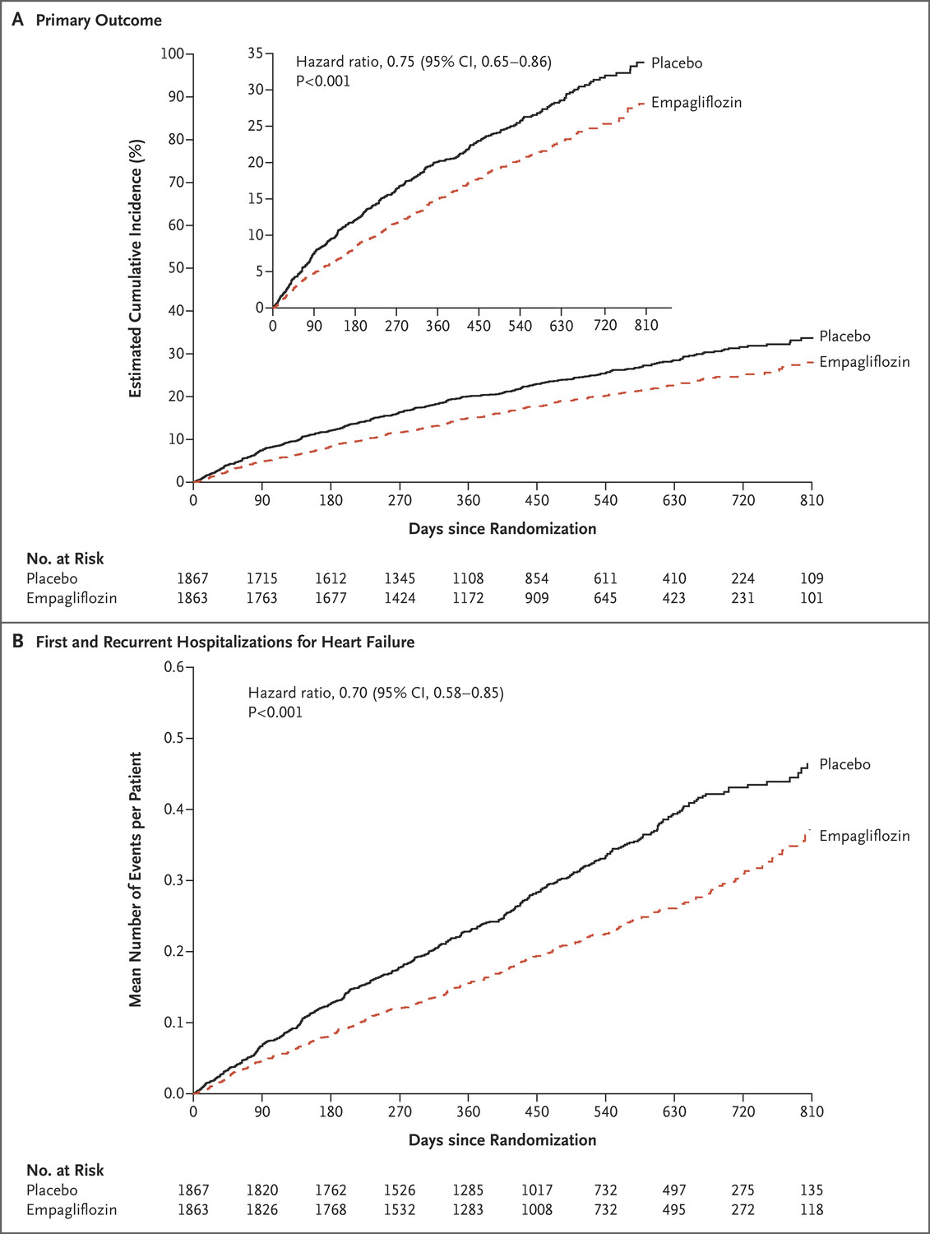
SGLT2i in HFrEF
25% RRR
30% RRR
Packer et al. NEJM 2020

Slide 51
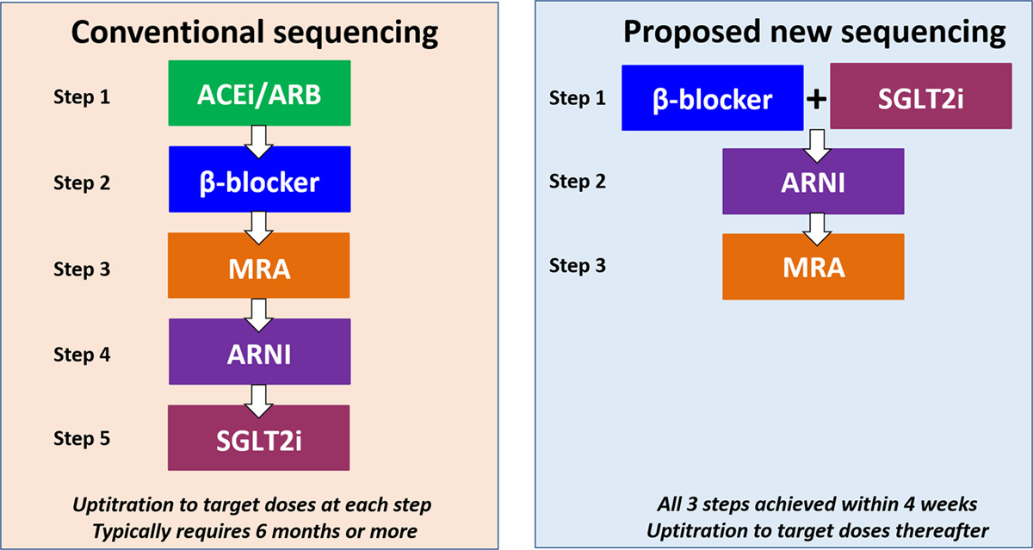
Early Initiation and Optimisation in HFrEF
Estimated benefit of all 4 drugs 73% RRR in all-cause mortality, NNT 3.9, extend median survival 7-11 years
McMurray et al. Circulation 2020
Greene et al. Circulation 2024

Slide 52
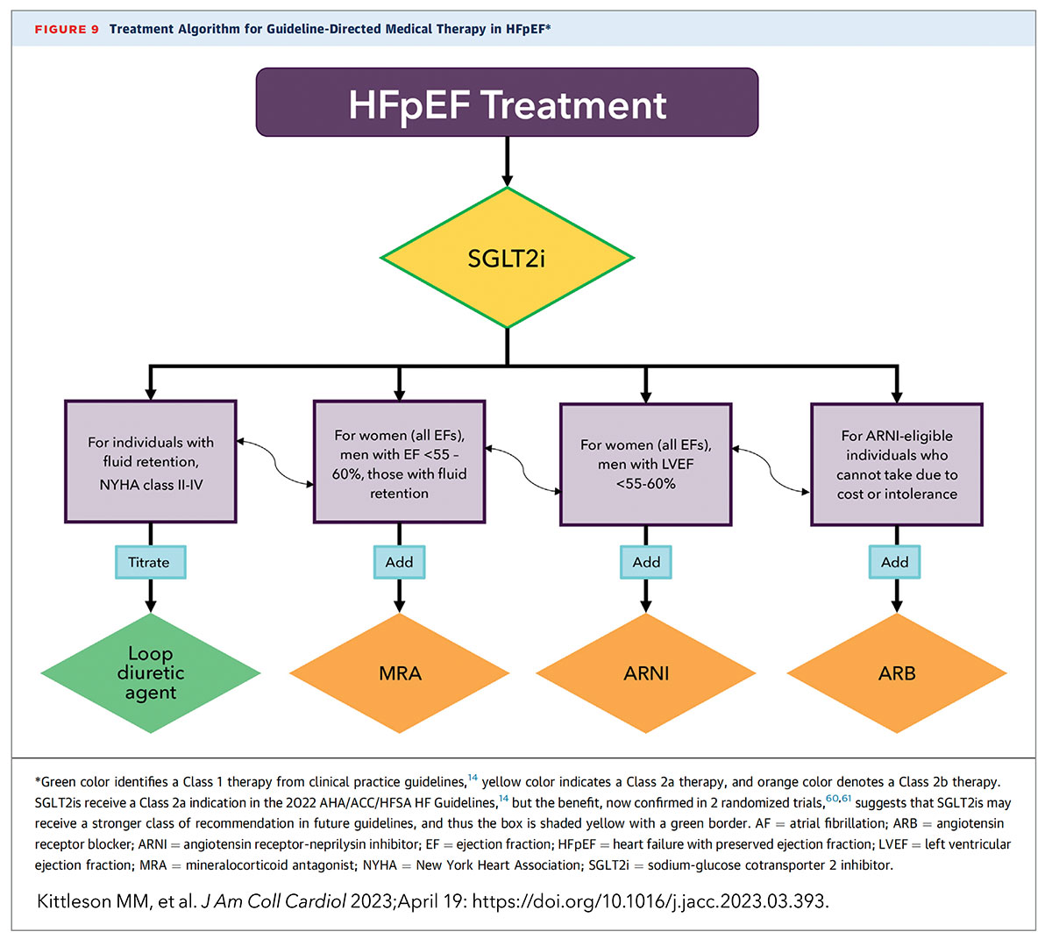
Treatment of Heart Failure is the Same With or Without Diabetes
HFpEF
Kittleson et al. JACC 2023

Slide 53
SGLT2i in HFpEF
Anker et al. NEJM 2021

Slide 54
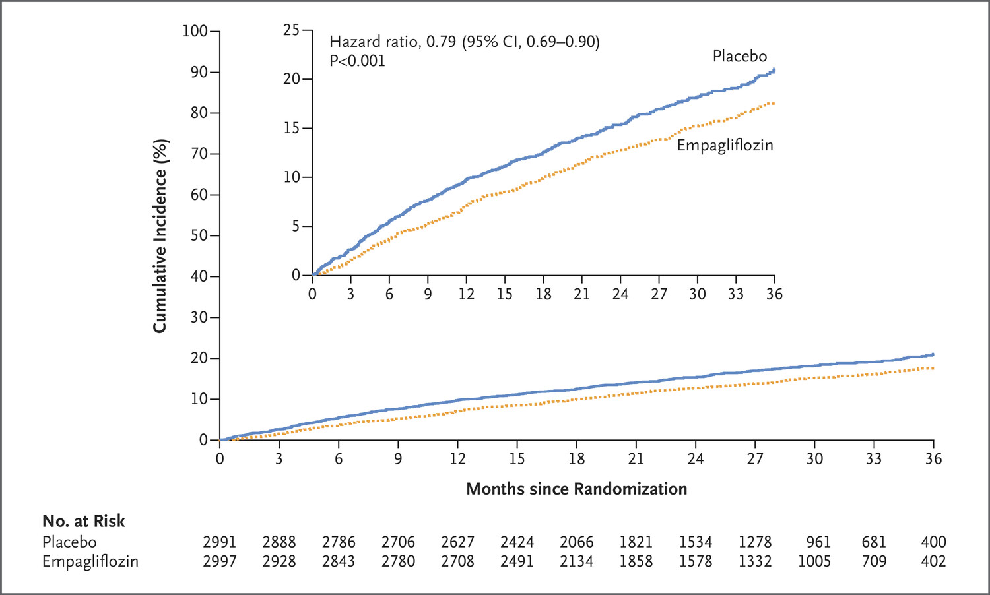
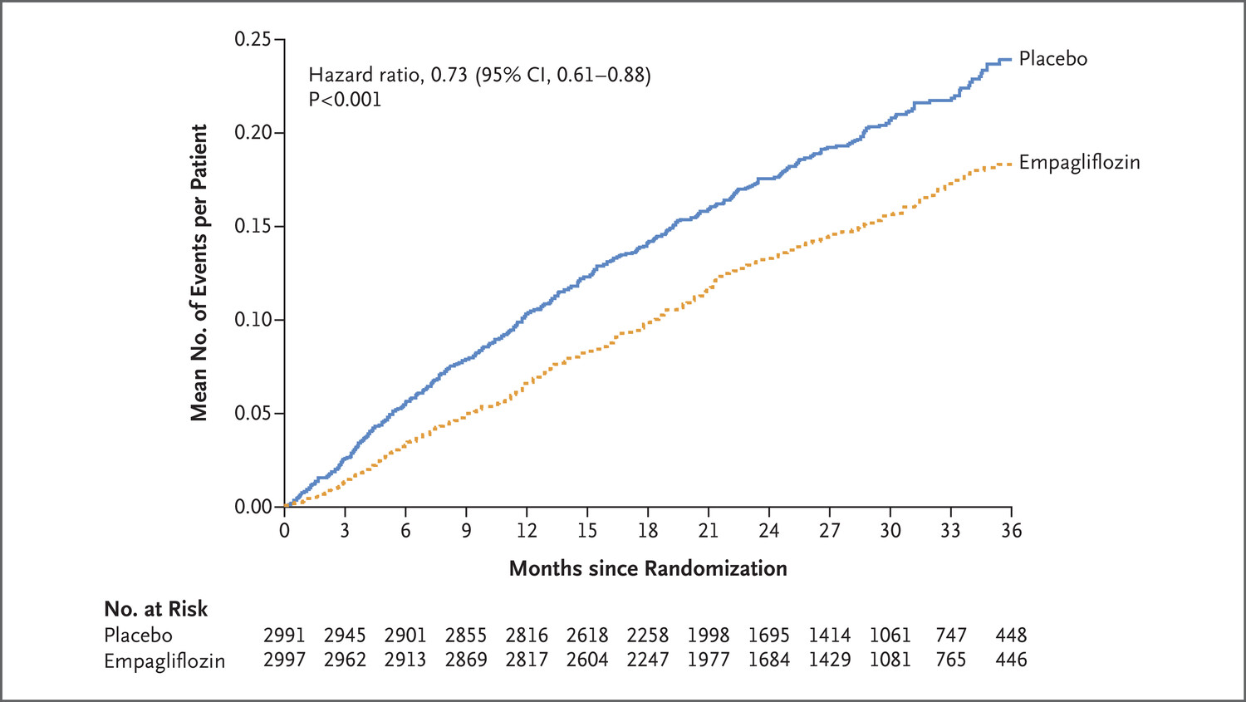
SGLT2i in HFpEF
21% RRR
27% RRR
Anker et al. NEJM 2021

Slide 55
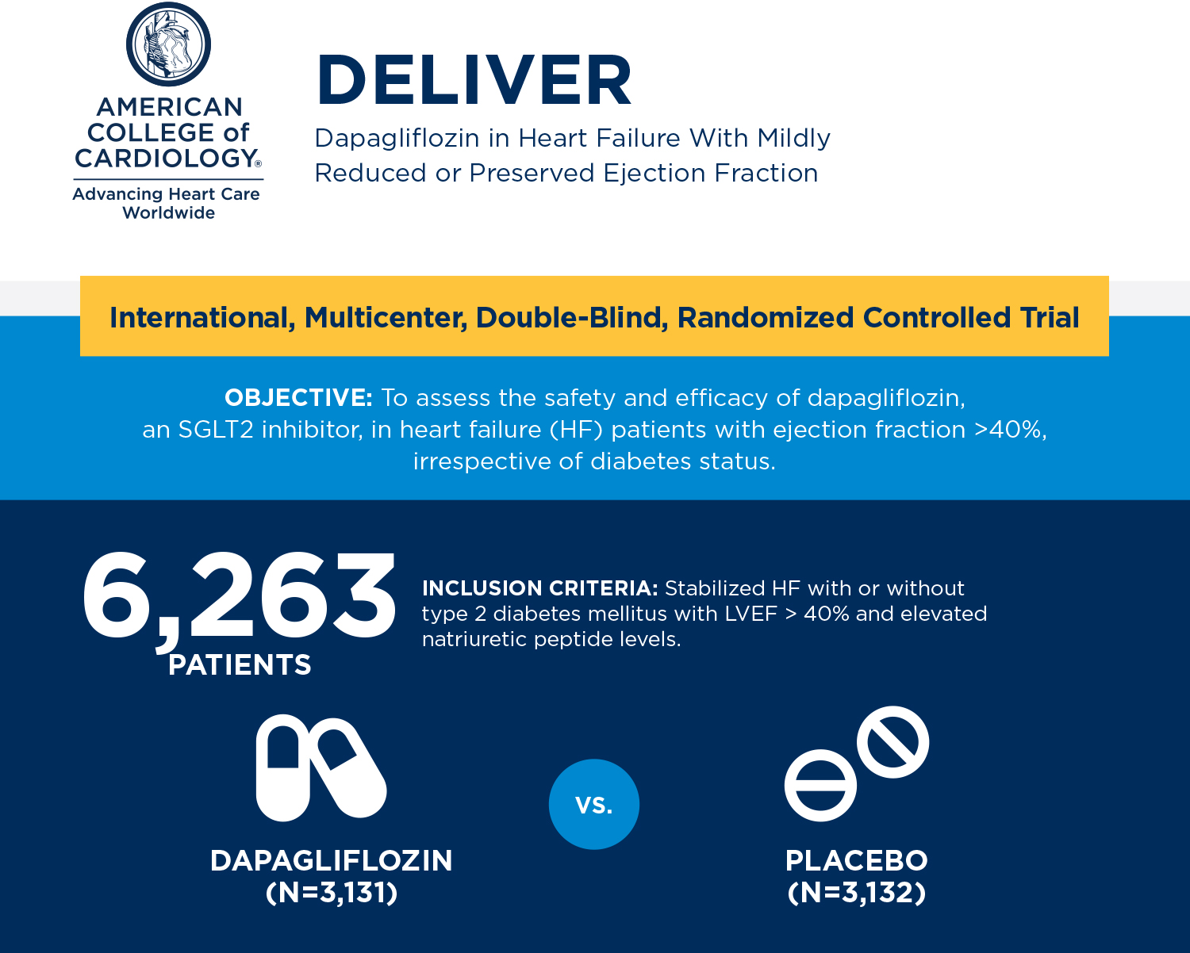
SGLT2i in HFpEF
Solomon et al. NEJM 2022

Slide 56
SGLT2i in HFpEF
18% RRR
21% RRR
Solomon et al. NEJM 2022

Slide 57
Consistent Beneficial Effects Irrespective of Diabetes Status: SGLT2 Inhibitors
Vaduganathan et al. Lancet 2022

Slide 58
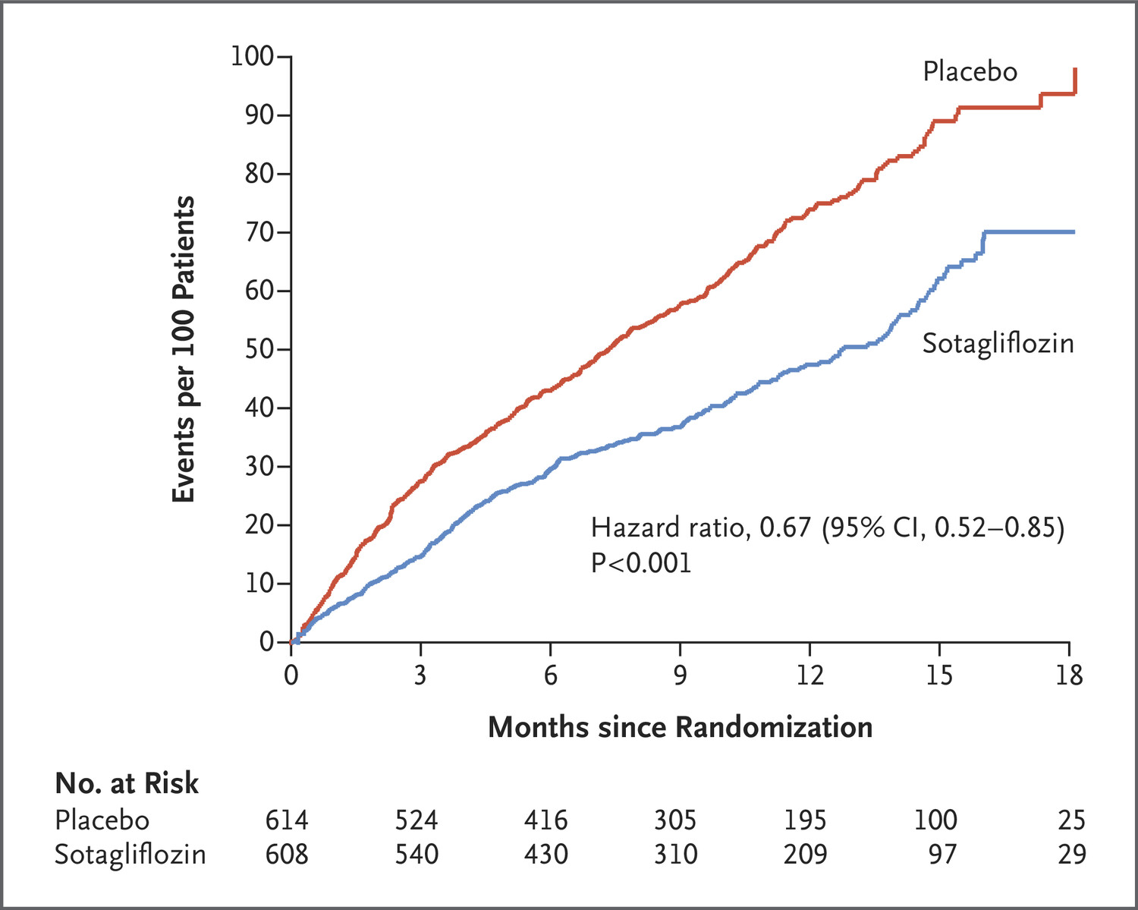
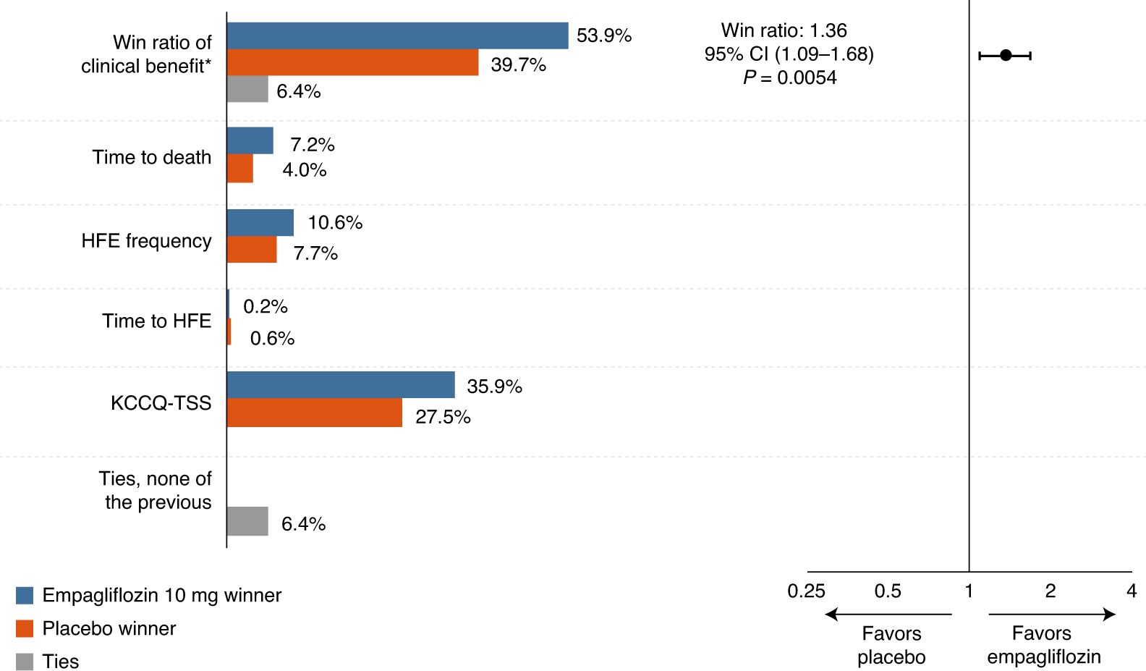
SGLT2i Can Be Used in Acutely Hospitalised Patients
SOLOIST-WHF (sotagliflozin, T2D only)
33% RRR (total number of deaths from cardiovascular causes and hospitalizations and urgent visits for heart failure)
EMPULSE (empaagliflozin, 45% T2D)
36% RRR more likely to benefit with SGLT2i
Bhatt et al. Lancet 2020
Voors et al. Nat Med 2022

Slide 59
SGLT2 Inhibitors – Exacerbating the Outcome Gap
Heart Failure Treatment
No Diabetes
ACEI/ARB/ARNI
Beta-Blocker
MRA
SGLT2i
Type 2 Diabetes
ACEI/ARB/ARNI
Beta-Blocker
MRA
SGLT2i
Type 1 Diabetes
ACEI/ARB/ARNI
Beta-Blocker
MRA
SGLT2i

Slide 60
SOPHIST: Trial Design
UK-wide multi-centre trial
Double-blind, placebo-controlled
320 participants with type 1 diabetes and heart failure
Intervention: Sotagliflozin 200mg daily or matched placebo
Primary Endpoint: Change in quality of life from baseline measured by KCCQ clinical summary score at 16 weeks

Slide 61
Key Inclusion/Exclusion Criteria
INCLUSION
Age ≥18 years.
Type 1 diabetes.
Insulin dose ≥0.5 units/kg body weight at screening or BMI ≥25kg/m².
NYHA II-IV HF with any LVEF
Elevated NTproBNP (≥250 ng/mL sinus, ≥400 ng/mL AF).
KCCQ clinical summary score <85 at screening.
EXCLUSION
Chronic kidney disease with eGFR <25.
Recent severe hypoglycaemia (hospitalisation/external assistance).
One episode of DKA or nonketotic hyperosmolar state within 1 month of screening or between screening and randomisation, or ≥2 diabetic events within 6 months of screening.
Unable or unwilling to use continuous glucose monitor during the trial.

Slide 62
On the Horizon – Non-Steroidal MRAs
Consistent in pooled finerenone analysis (FINEARTS, FIDELIO, FIGARO)
FINEARTS-HF: significant reduction in CV death/HF hospitalisation in HFpEF (HR 0.84 (0.74-0.95), p=0.007) independent of diabetes status
Solomon et al. NEJM 2024
Vaduganathan et al Nat Med 2024

Slide 63
Diabetes Treatments in Individuals with Heart Failure: Beyond SGLT2 Inhibitors
Metformin
Sulfonylureas
DPP-4 Inhibitors
Thiazolidinediones (TZDs)
Insulin
GLP1/GIP
Vaduganathan et al. Lancet 2022

Slide 64
Metformin in Diabetic Heart Failure: Possible Benefit?
No strong RCT-level data; meta-analysis of 34,000 individuals in observational studies
Eurich et al. Circ HF 2013

Slide 65
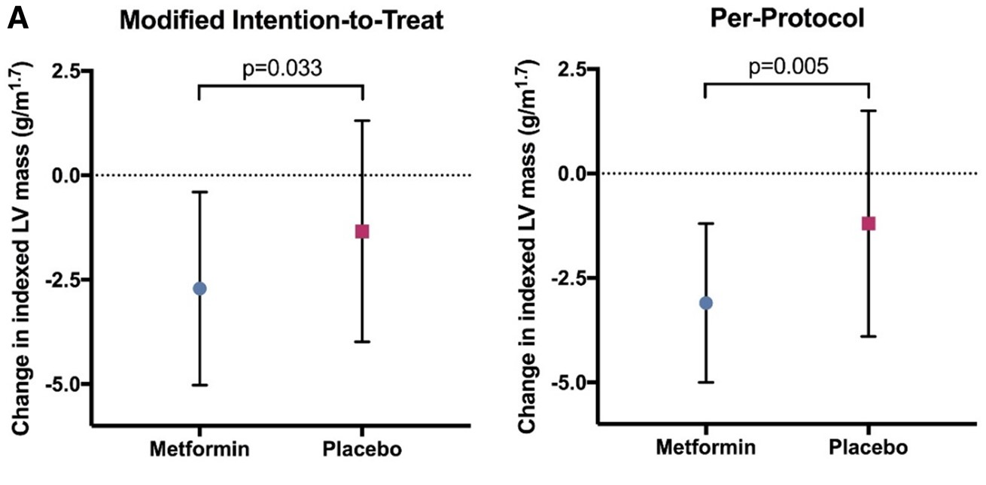
Metformin Reduced LV Mass in Stage B Heart Failure Without Diabetes
Mohan et al. EHJ 2019

Slide 66
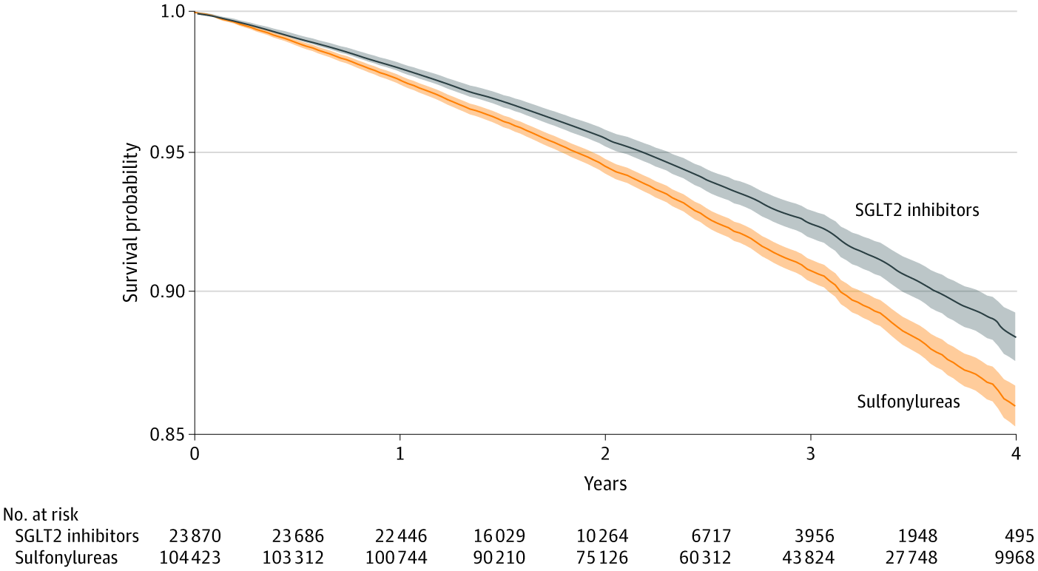
Sulfonylureas: Probably Neutral at Best
Real-world data in >128,000 T2D, increased risk of all-cause mortality compared to SGLT2i (HR 0.66 (0.60-0.74))
Xie et al. JAMA Int Med 2021

Slide 67
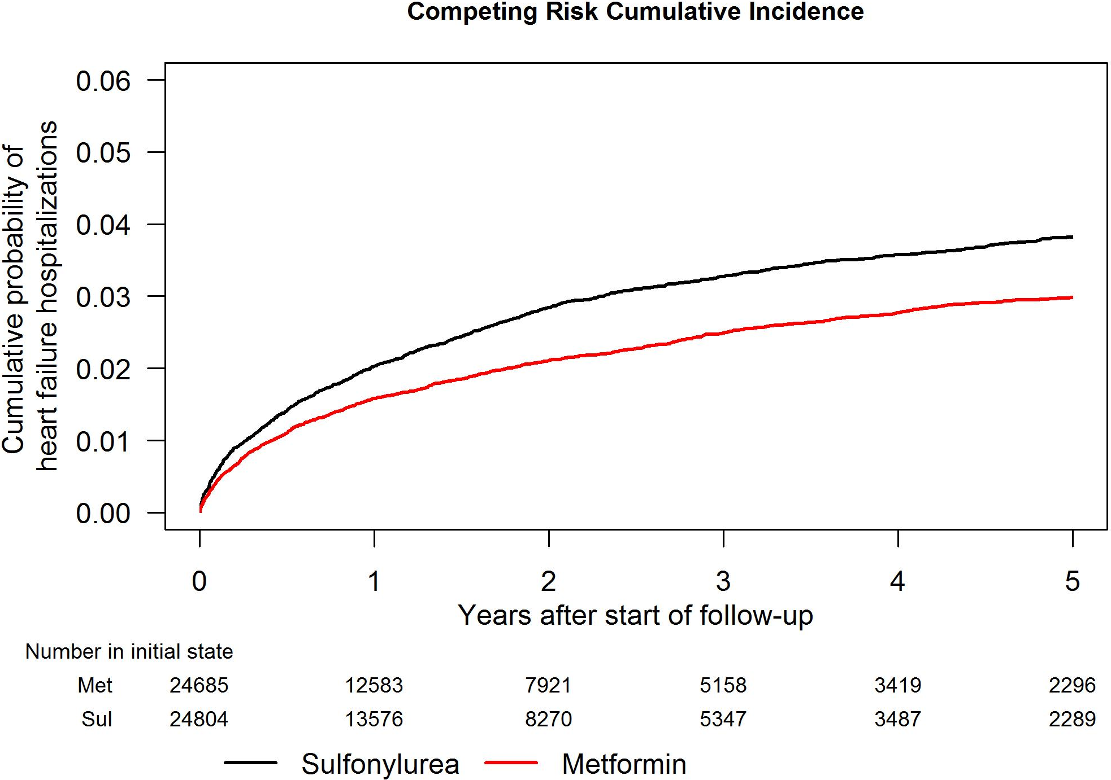
Sulfonylureas: Probably Neutral at Best
Increased risk of incident HF compared to metformin (3.8% vs. 3.0% at 5 years) in individuals with T2D and CKD
Richardson et al. JAHA 2021

Slide 68
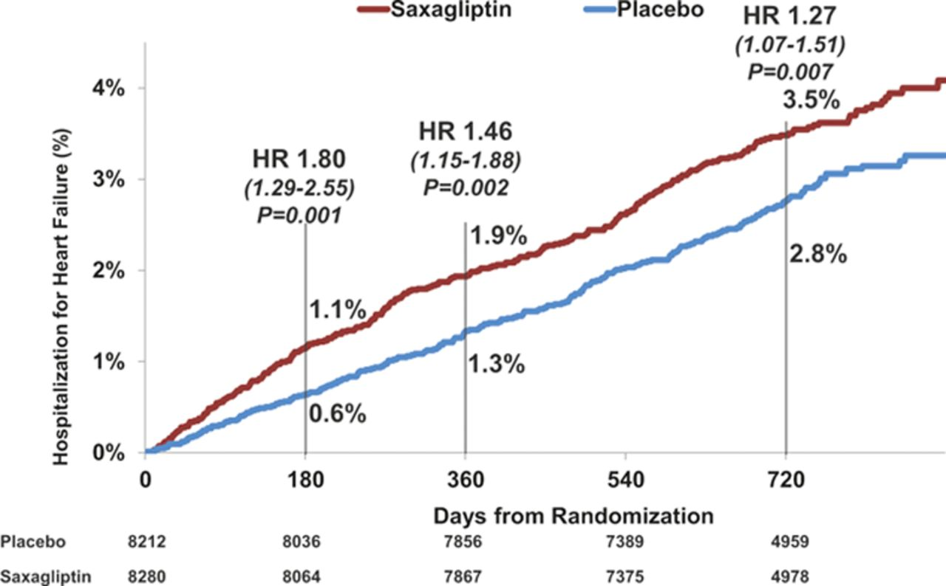
DPP-4: Mixed, not recommended
Saxagliptin
Alogliptin
Increased incidence of HF hospitalisation in SAVOR-TIMI (HR 1.26 (1.02-1.55), p=0.04
Increased numerical incidence in EXAMINE based on baseline NTproBNP
Scirica et al Circulation 2014
Zannad et al. Lancet 2015

Slide 69
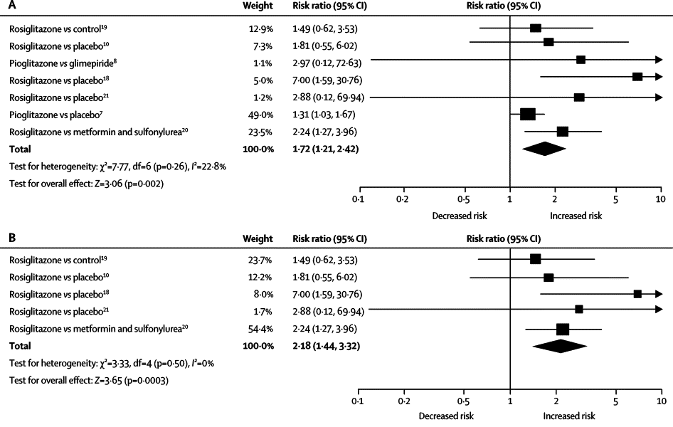
TZDs: Avoid!
Meta-analysis of 7 RCTs (20,191 individuals), significantly increased risk of HF with TZDs ~2-fold
Lago et al. Lancet 2024

Slide 70
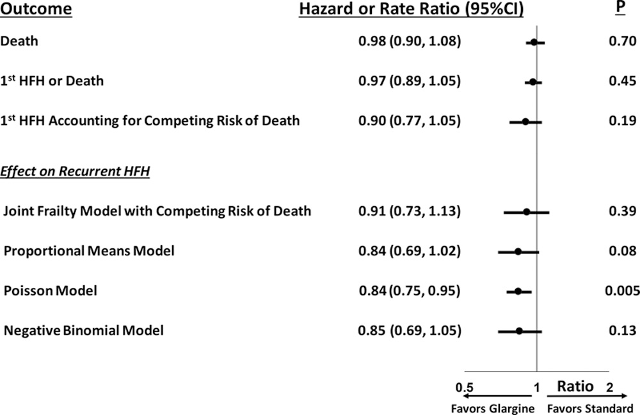
Insulin: Probably neutral but watch for weight gain etc.
ORIGIN RCT (12,537 participants, insuline glargine vs. no insulin), neutral effect (in contrast to observational studies)
Gerstein et al. Circulation 2018

Slide 71
GLP1/GIP RAs: A New Tool in Armoury!

Slide 72
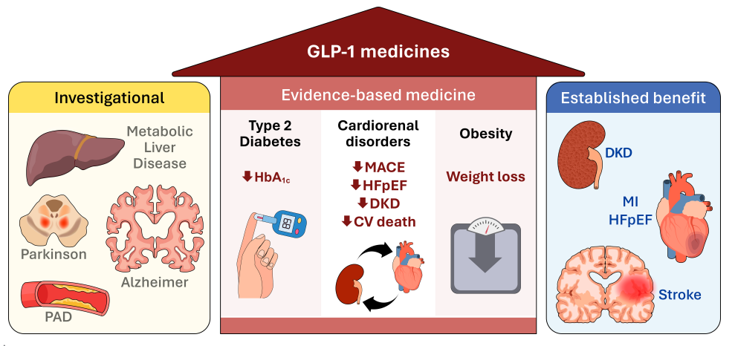
GLP1/GIP RAs: A New Tool in the Armoury!
Drucker DJ Diabetes Care 2024; 47: 1-16

Slide 73
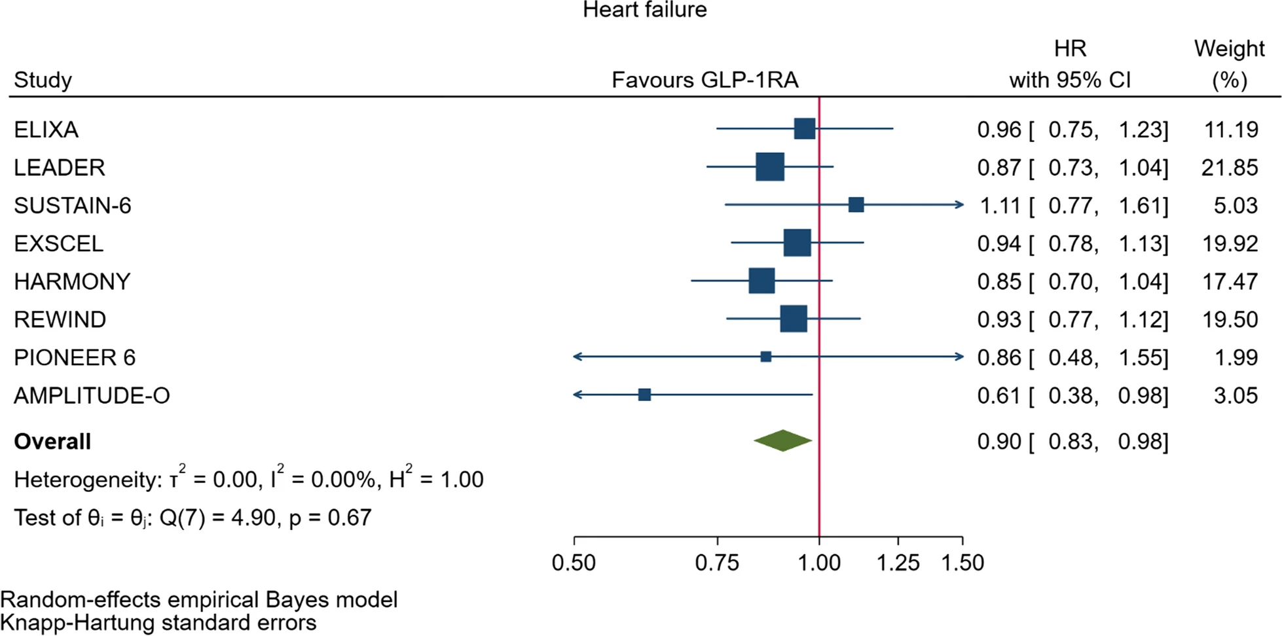
GLP1/GIP Ras: Mixed Evidence from T2D Trials but Perhaps a Signal of Benefit
Giugliano et al. Cardiovasc Diabetol 2021

Slide 74
Semaglutide and HF: Evidence from SELECT
Deanfield et al. Lancet 2024

Slide 75
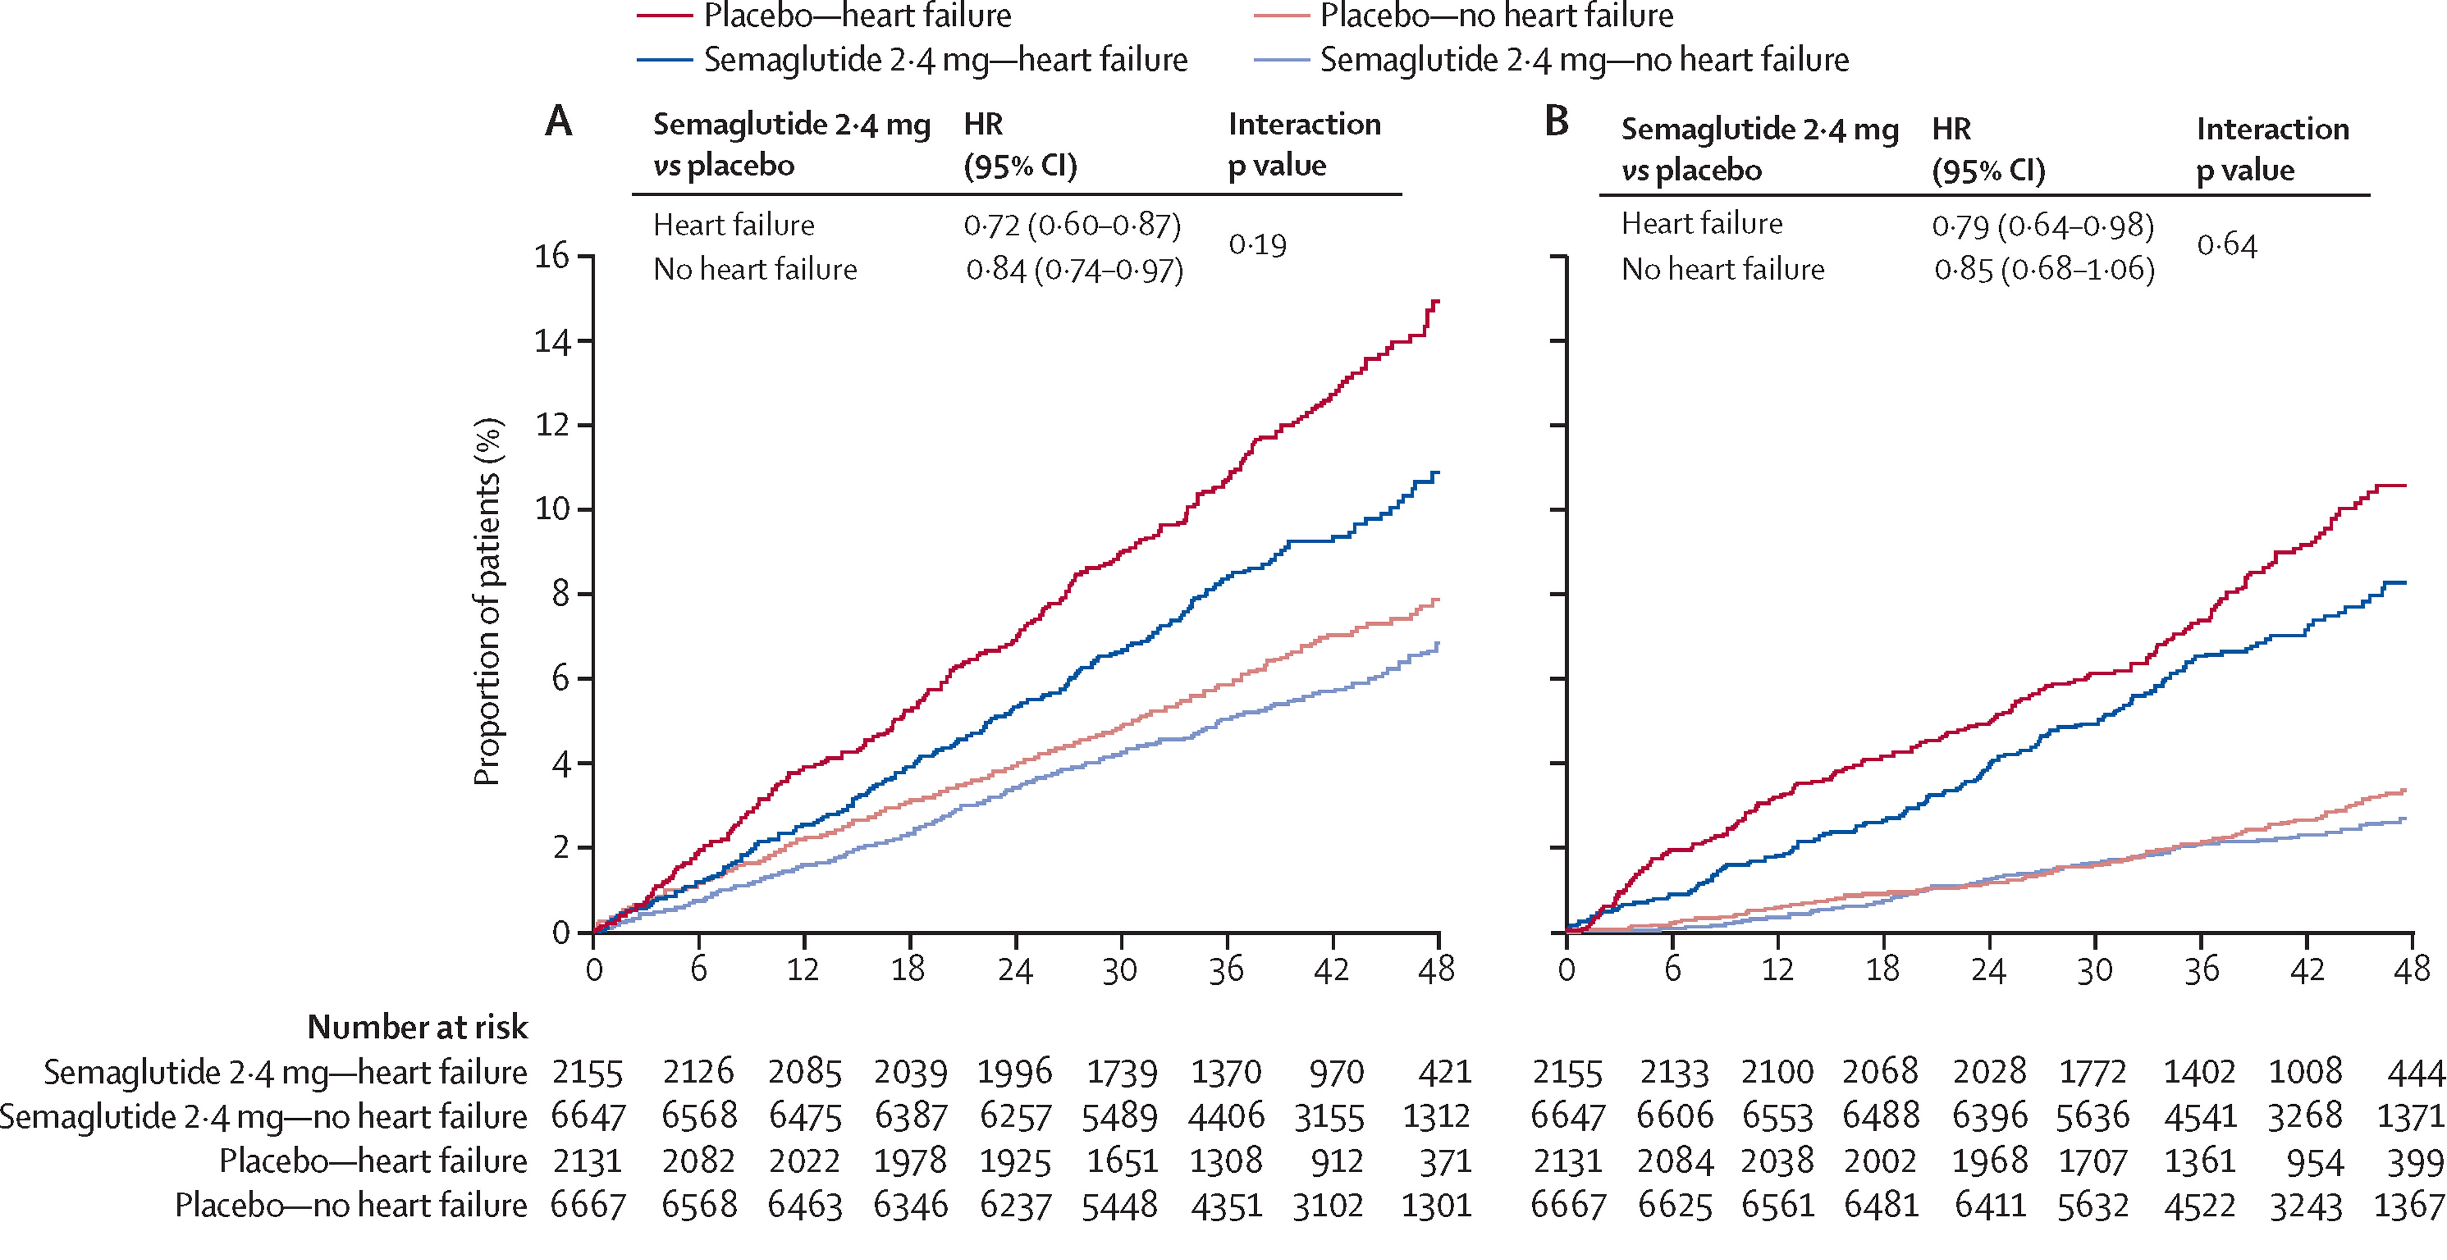
Semaglutide and HF: Evidence from SELECT
~24% with HF at baseline, reduction in MACE regardless of HFrEF (HR 0.65 (0.49-0.87) or HFpEF 0.69 (0.51-0.91)
Deanfield et al. Lancet 2024

Slide 76
STEP-HFpEF DM: Symptomatic Benefit of Semaglutide in Individuals with T2D and HFpEF
Kosiborod et al. NEJM 2023

Slide 77
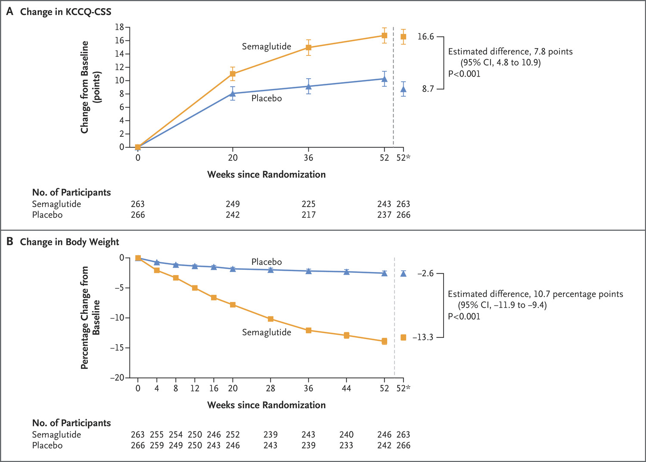
STEP-HFpEF DM: Symptomatic Benefit of Semaglutide in Individuals with T2D and HFpEF
529 individuals with T2D and HFpEF, significant improvements in quality of life, body weight, NTproBNP and exercise capacity
Kosiborod et al. NEJM 2023

Slide 78
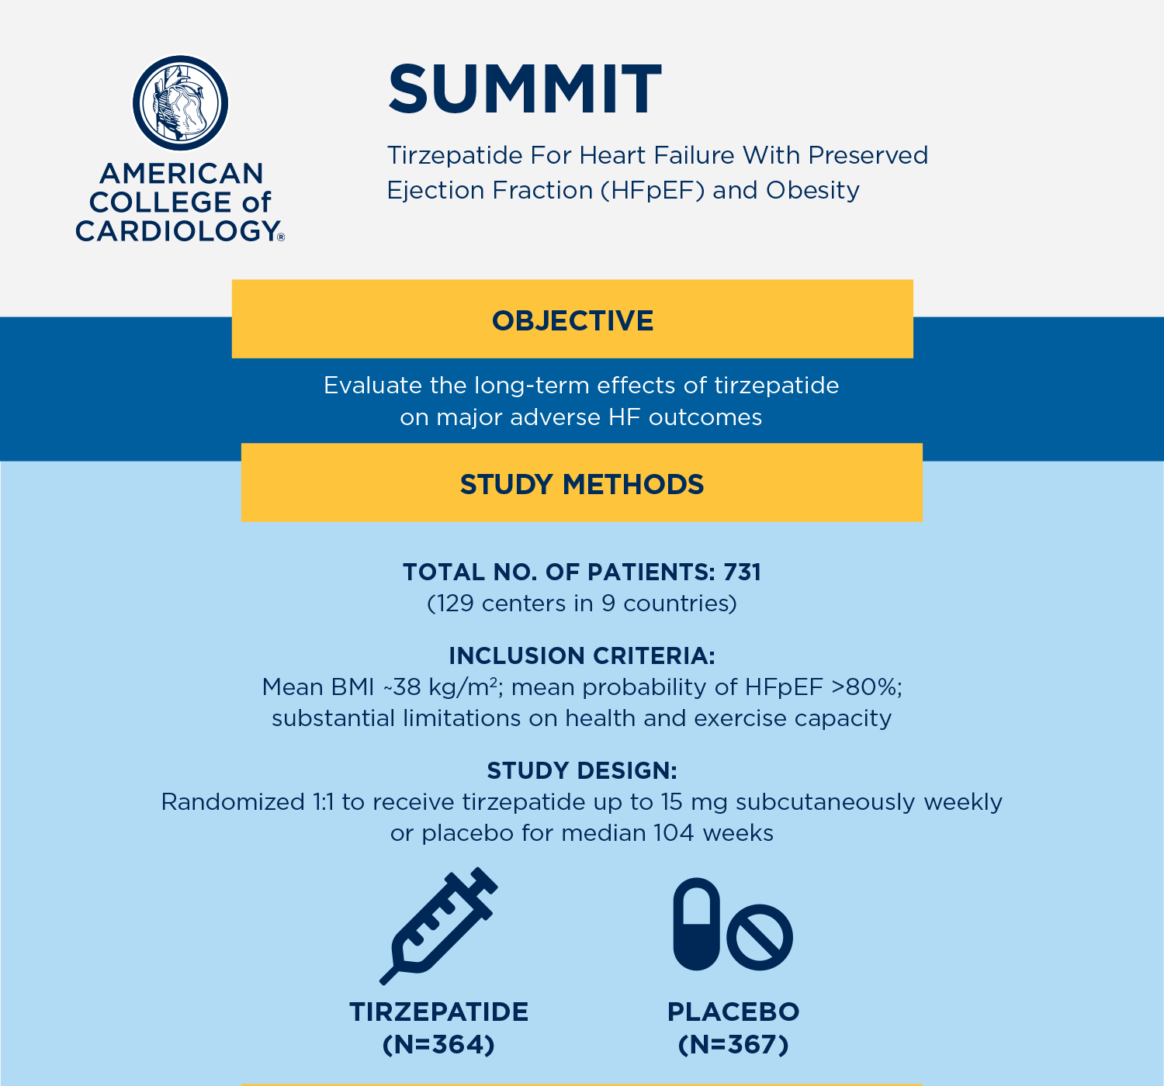
SUMMIT: Significant Treatment Benefit with Tirzepatide in HFpEF
Packer et al. NEJM 2024

Slide 79
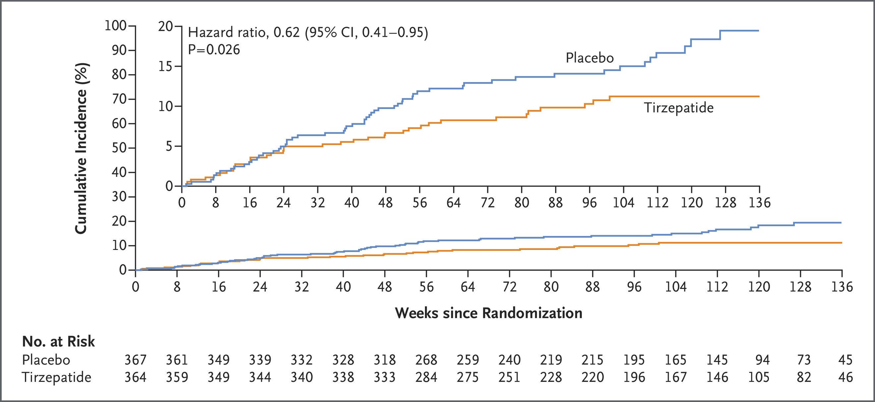
SUMMIT: Significant Treatment Benefit with Tirzepatide in HFpEF
731 individuals with HFpEF and obesity (48% T2D), 38% RRR on CV death/HF hospitalisation (HR 0.62, 0.41-0.95, p=0.026)
Packer et al. NEJM 2024

Slide 80
SUMMIT: Significant Improvement in Quality of Life and Exercise Capacity with Tirzepatide in HFpEF
KCCQ (Quality of Life)
+6.9; (3.3 to 10.6); p<0.001
6-Minute Walk Test Distance
+18.3m; (9.9 to 26.7); p<0.001
Packer et al. NEJM 2024

Slide 81
SUMMIT: Significant Reduction in Body Weight with Tirzepatide in HFpEF
−11.6% (−12.9 to −10.4); p<0.001
Packer et al. NEJM 2024

Slide 82
SUMMIT: Reductions in Cardiovascular Biomarkers
↓CRP
↓Troponin
↓NTproBNP
Borlaug et al. Nat Med 2024

Slide 83
SUMMIT: Beneficial Cardiac Remodelling
Kramer et al. JACC 2024

Slide 84
Potential Mechanisms of Benefit for GLP1RAs

Slide 85
GLP/GIP in HF
Vaduganathan et al. JACC 2023

Slide 86
Diabetes Treatments in Individuals with Heart Failure
SGLT2 Inhibitors ✔✔
Metformin --
Sulfonylureas --
DPP-4 Inhibitors x
Thiazolidinediones (TZDs) xx
Insulin --
GLP1/GIP ✔ (HFpEF; HFrEF?)
Vaduganathan et al. Lancet 2022

Slide 87
Diabetes Treatment in HF
ADA 2024

Slide 88
Summary
A really exciting time!
Type 2 diabetes (T2D) is an independent risk factor for Heart Failure (HF) and increases the risk of HF hospitalisations and mortality
Heart Failure is underdiagnosed in people with Type 2 diabetes and often the FIRST cardiac complication to present in people with T2D
Important to prevent HF in T2DM. To do this, we need to focus on identifying patients early in the disease i.e., Stage A and Stage B HF when patients are asymptomatic
Once patients become symptomatic (Stage C HF), consider the 4 pillars of HF therapy (RAS blockers, BBs, MRAs and SGLT2i)
Heart Failure management should aim to prevent hospital admission, relieve signs and symptoms, improve survival and should include patient centred shared decision making

Slide 89
Management of HF in Diabetes in 2025?
Stage A/B HF
Early screening (NTproBNP, hsTn)
ACEI
SGLT2i
GLP1/GIP (if obese)
nsMRA (if CKD)
HFrEF
ARNI/(ACEI, ARB)
Beta-blocker
MRA (spironolactone, eplerenone)
SGLT2i
All first-line
HFpEF
SGLT2i
GLP1/GIP
nsMRA (in all)

Slide 90
Summary: The Future
nsMRA
GLP1/GIP
SGLT2i
Diabetes and Heart Failure
Early Intervention

